Slide 1
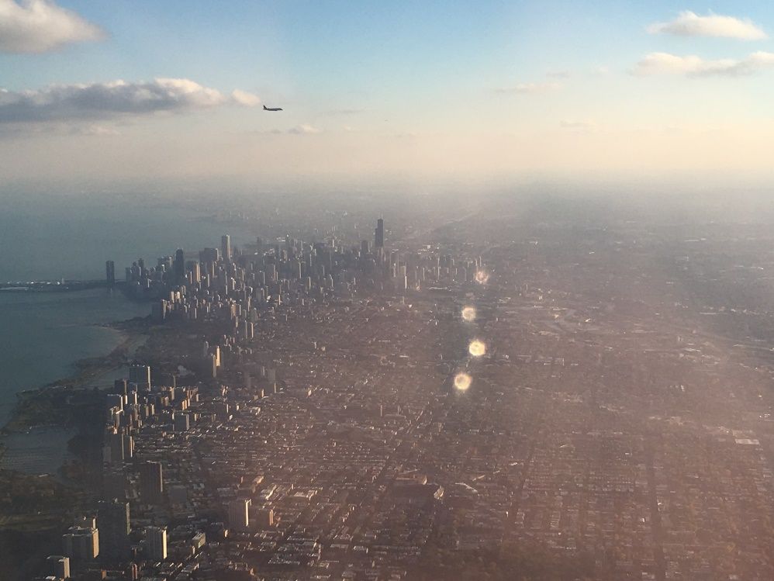
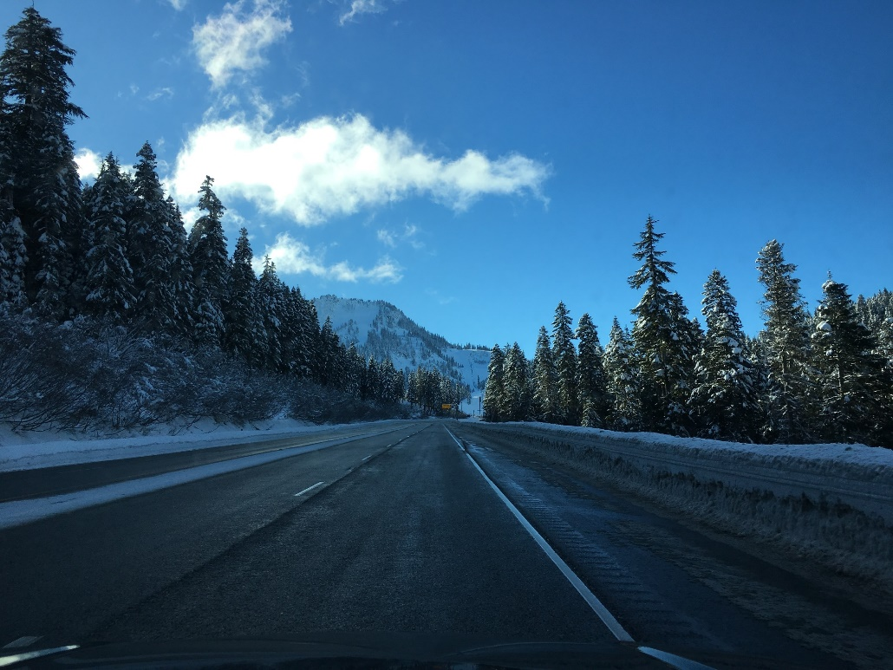
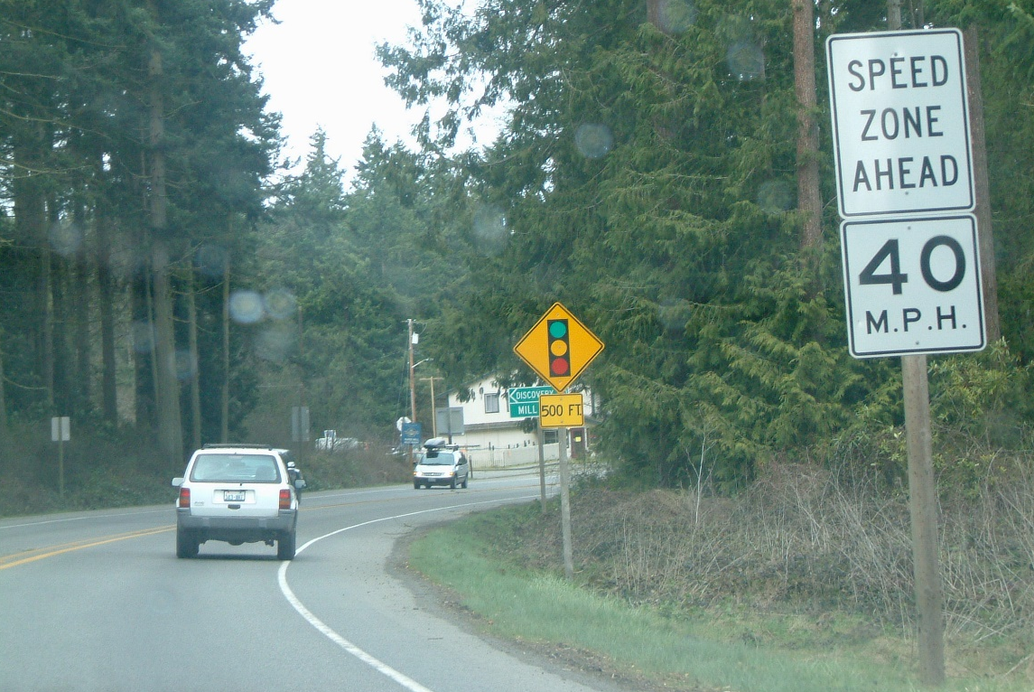
Washington LTAP Center Update

Slide 2
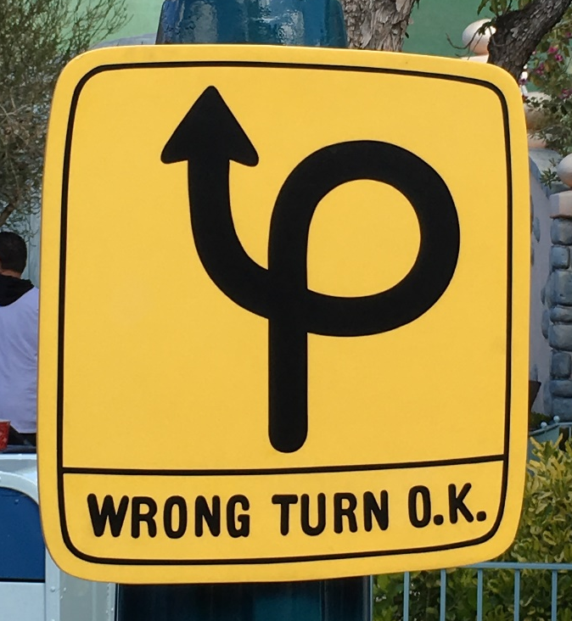
LTAP Center Structure
DOT-based Center
Within DOT, housed in Local Programs Division
2.75 FTE staff
Director
¾ time program manager / training coordinator
Online training developer

Slide 3
Training – Participants
3.0 FTE
2.5 FTE
3.5 FTE
2.75

Slide 4
Training – Courses
3.0 FTE
2.5 FTE
3.5 FTE
2.75

Slide 5
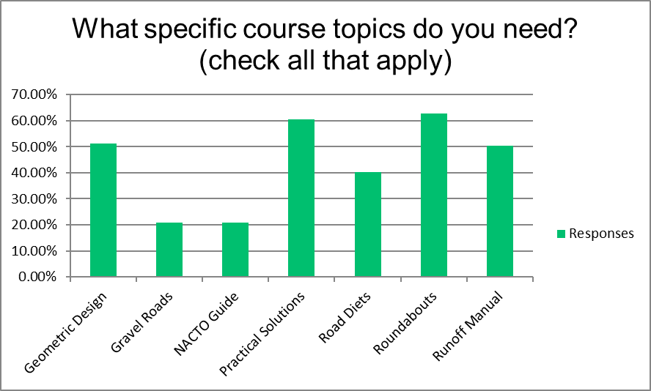
Training Survey
Category | Class | #
Contracts | Contract Management | 113
Construction | Construction Inspection Documentation | 111
Environmental | NEPA | 108
Pavements | Asphalt | 101
Pavements | Pavement Preservation | 98
Contracts | Spec Writing | 97
Construction | Materials | 96
Pedestrian/Bicycle | Ped/Bike Design | 93
Contracts | Cost Estimating | 90
Pedestrian/Bicycle | Safe Routes to School | 90
Other | ADA | 90
Other | Project Management | 89
Traffic | MUTCD | 86
Pedestrian/Bicycle | Complete Streets | 85
Design | Roundabouts | 81
Environmental | Cultural Resources | 81
Bridge | Bridge Inspection | 79
Pavements | Pavement Condition Rating | 79
Design | Practical Solutions | 78
Environmental | Biological Assessments | 78
Traffic | Traffic Analysis | 76
Pavements | Aggregates | 74
Safety | Roadside Safety | 74
Contracts | DBE | 71
Fall 2017
Evaluated 10+ years of training history
Online survey
Implementing based on results
Will conduct annual survey to update
Accessible online training…

Slide 6
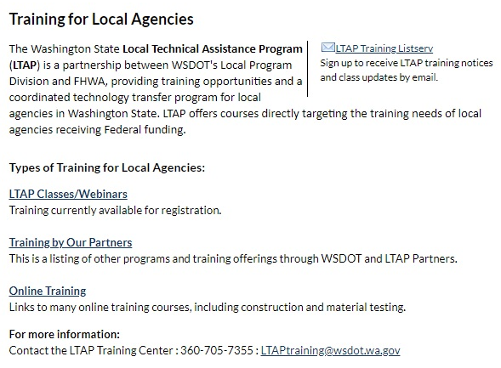
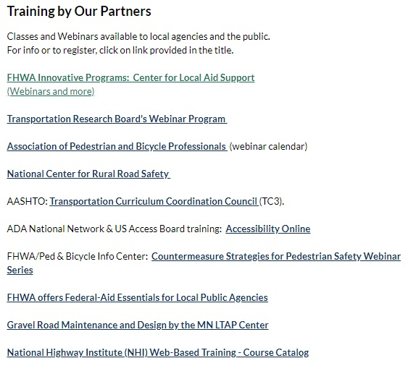
Communications
Website Re-Design
Listserv Emails
Blog

Slide 7
Technical Assistance: Safety
Counties – 2 Rounds of LRSP Development
33 of 39 counties have plans
4 of the remaining 6 attended training or are drafting a plan now
Cities – 1 Round of Development
22 cities submitted plans in 2018
Hosted a dozen workshops & a webinar on LRSP development
Summary/Comparison Data
Provided to all counties and cities with fatal/serious crashes
MIRE FDE – Surveys
SHSP 2019 Update

Slide 8
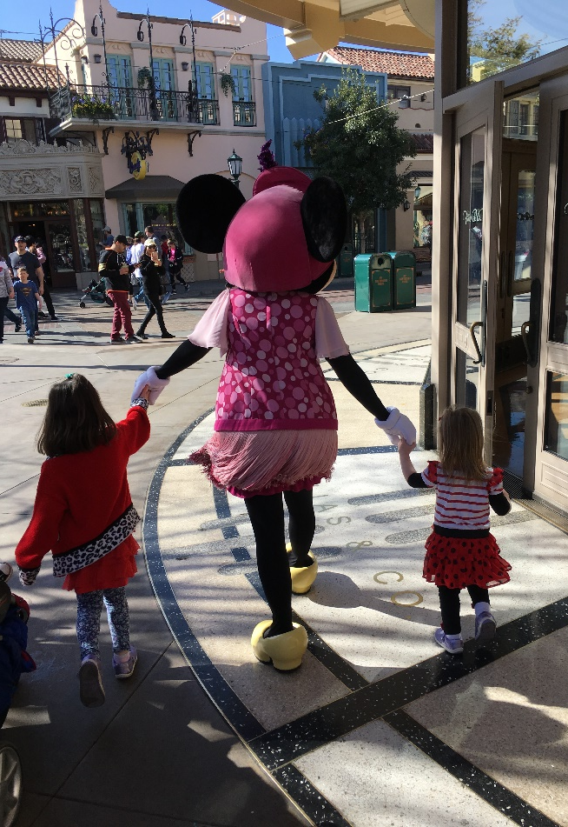
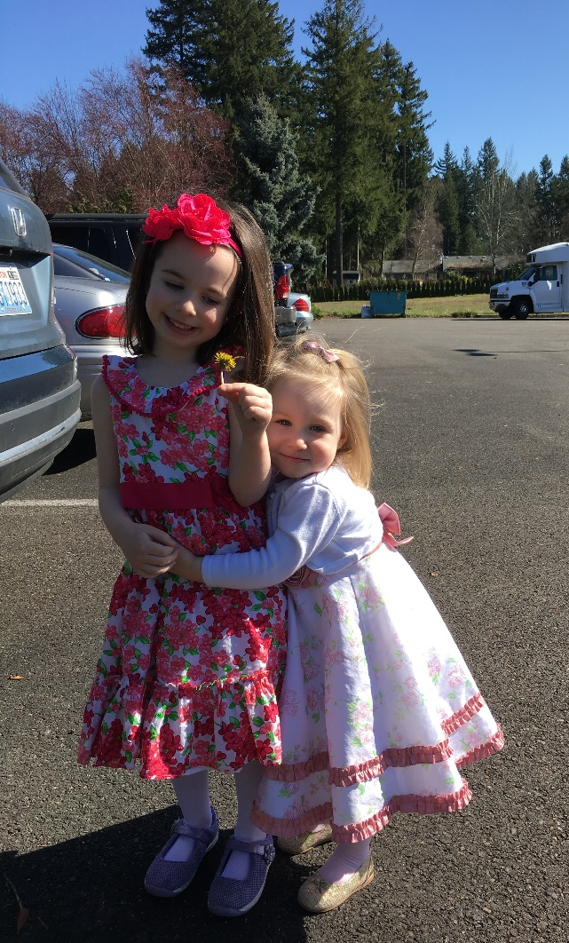
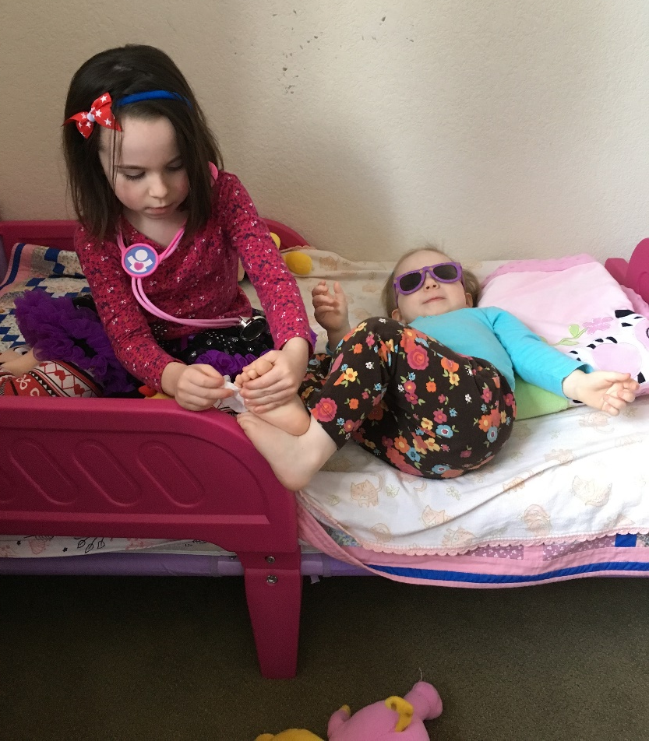
Questions?

