Slide 1

North Central Region Meeting
Estes Park, Colorado – May 22-23, 2018
North Dakota’s
LTAP Team

Slide 2
NDLTAP Update……
Success Stories
What’s New?
Challenges

Slide 3
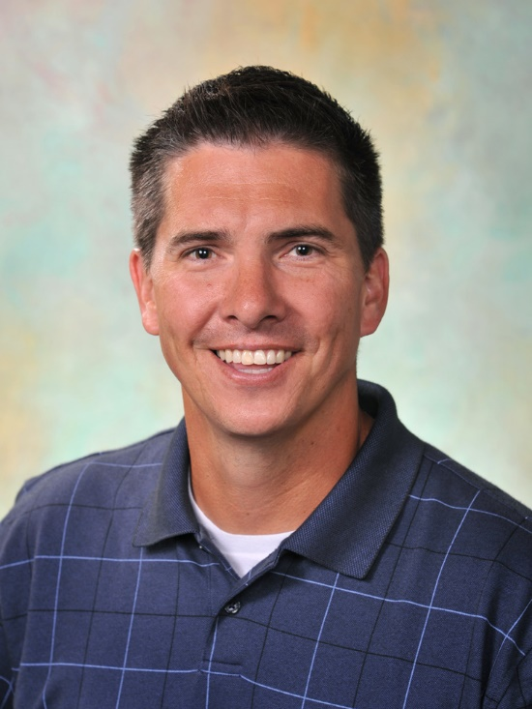

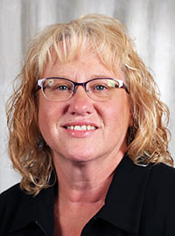
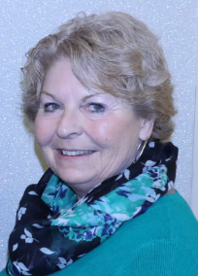
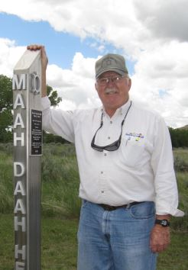
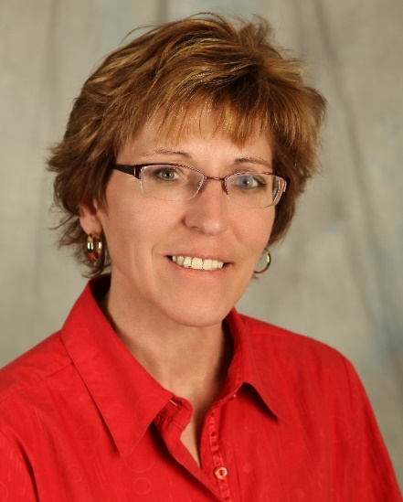

NDLTAP
TEAM

Slide 4


Slide 5
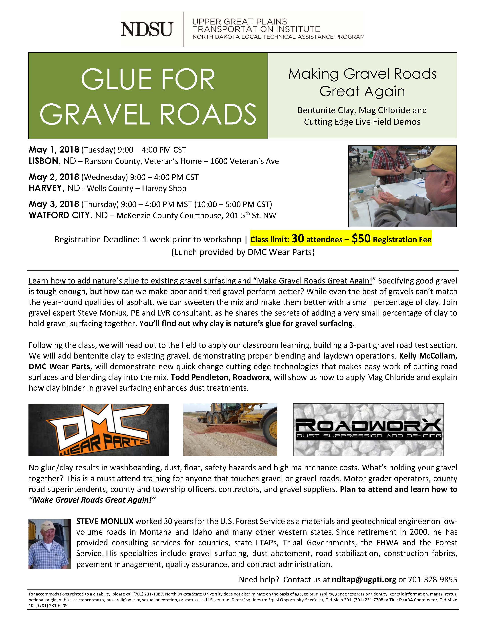
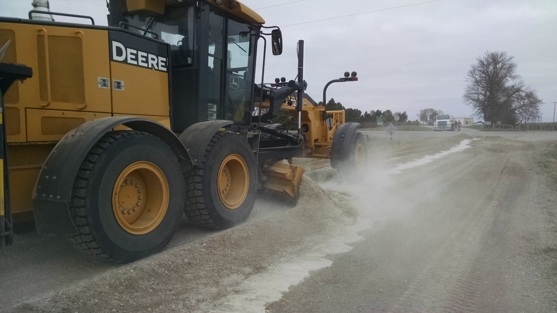

Slide 6


Slide 7
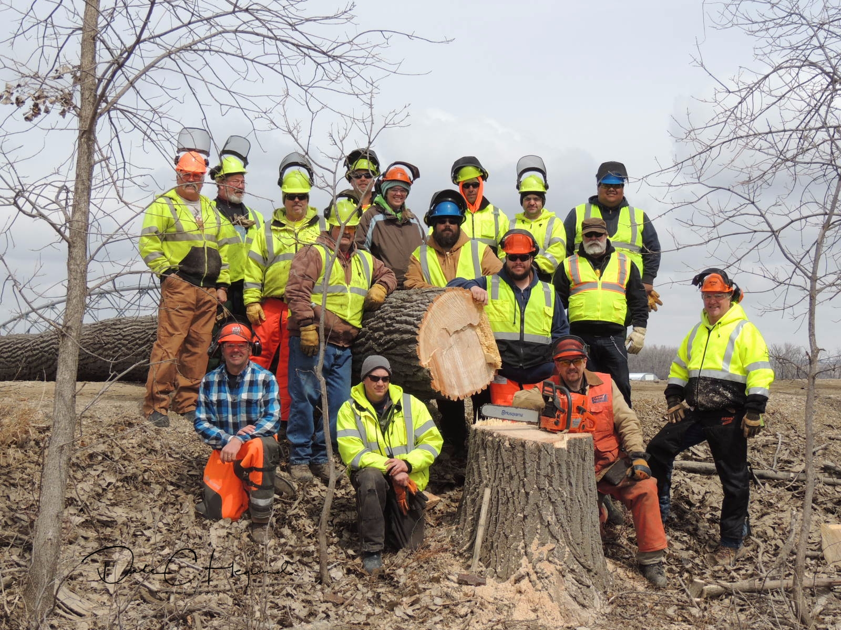

Slide 8

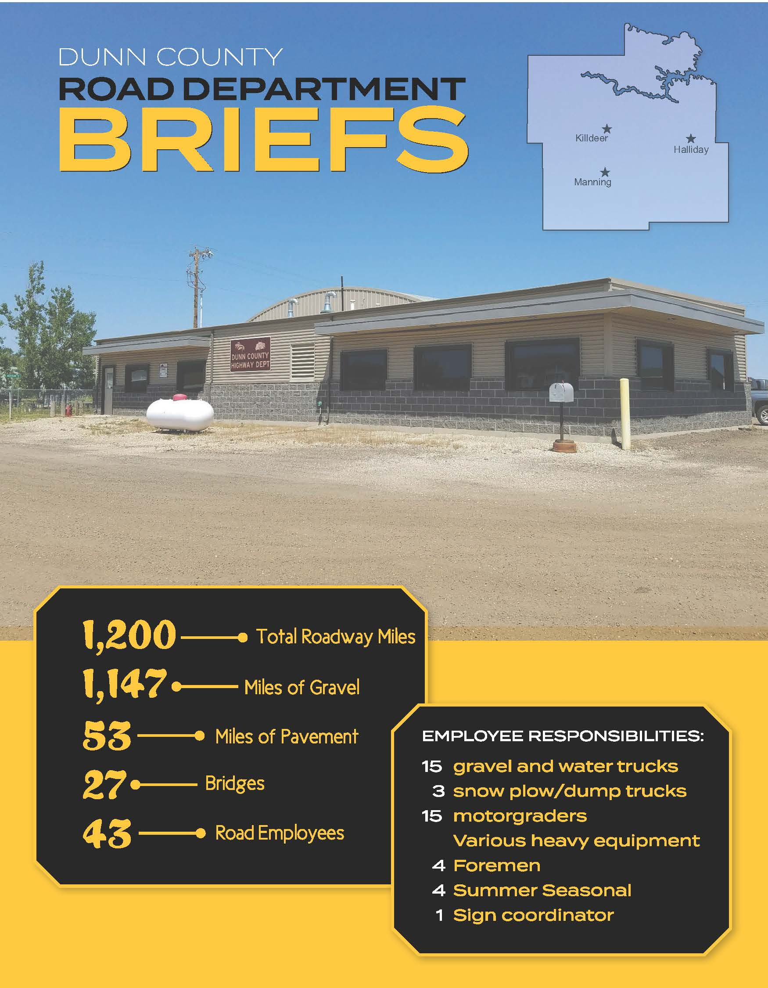

Slide 9
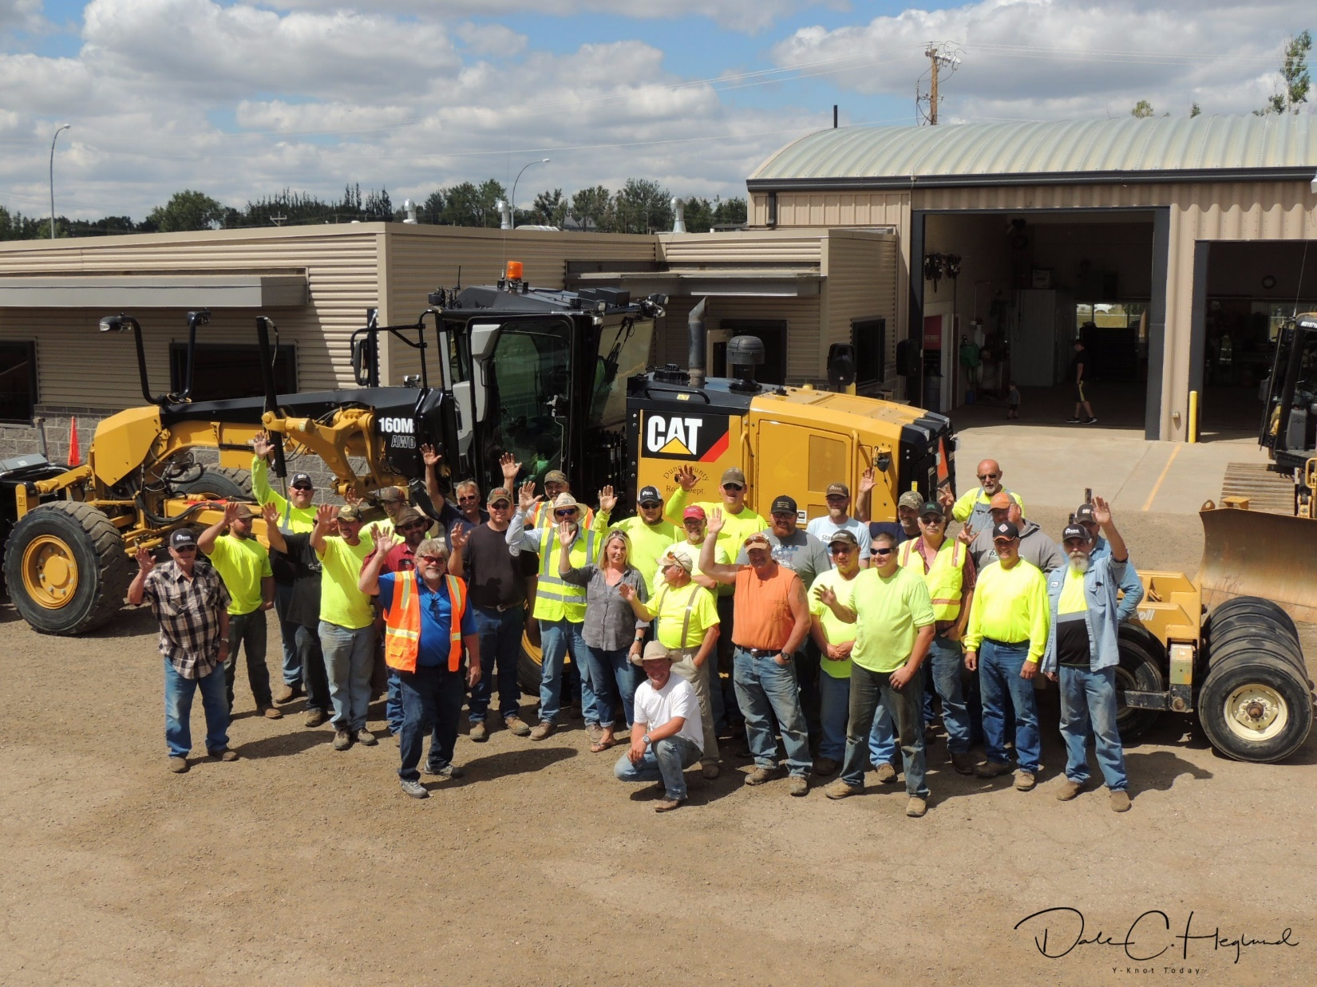

Slide 10
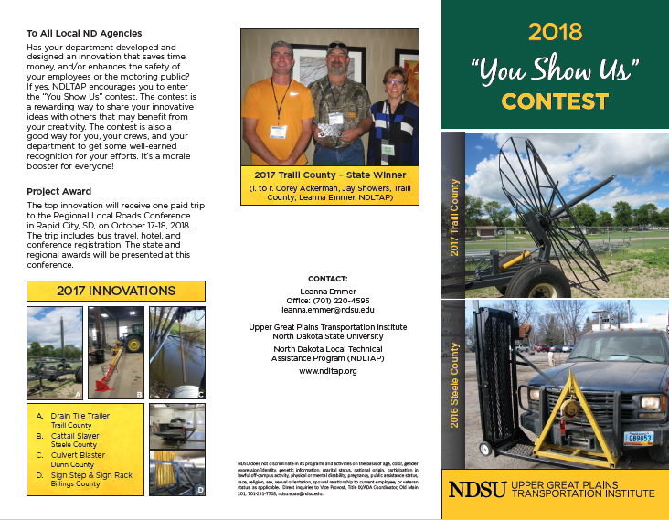

Slide 11
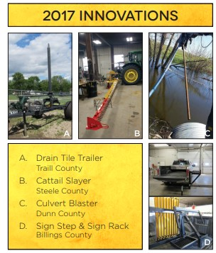

Slide 12

2018 – “Innovation -
The Key To Pavement Preservation”

Slide 13
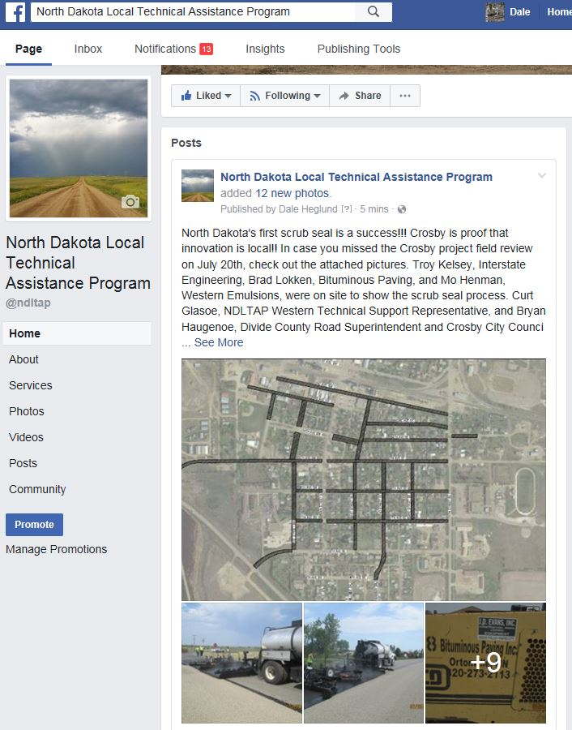
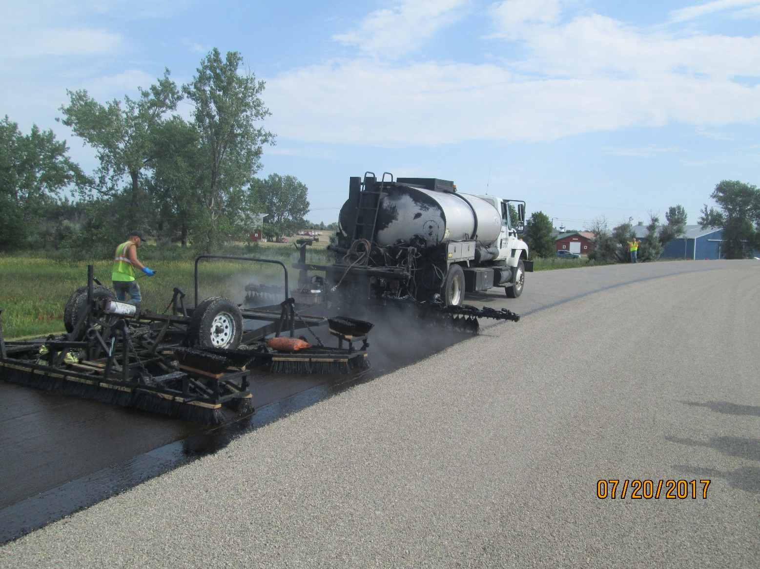

Slide 14
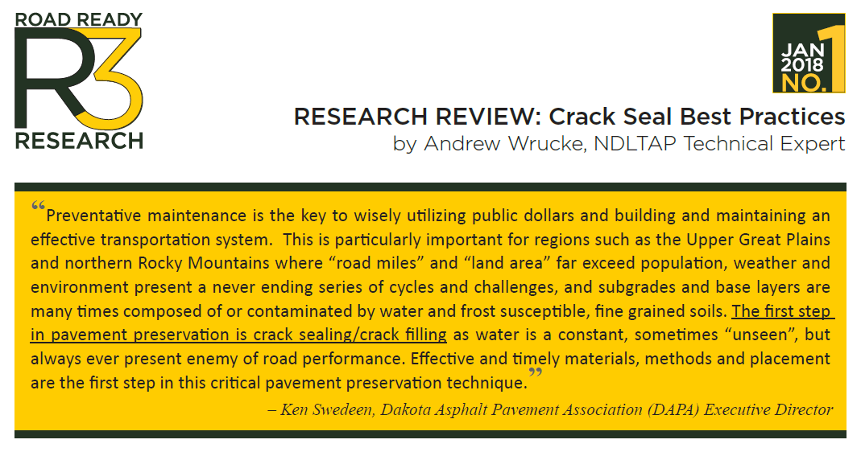


Road Ready Research

Slide 15

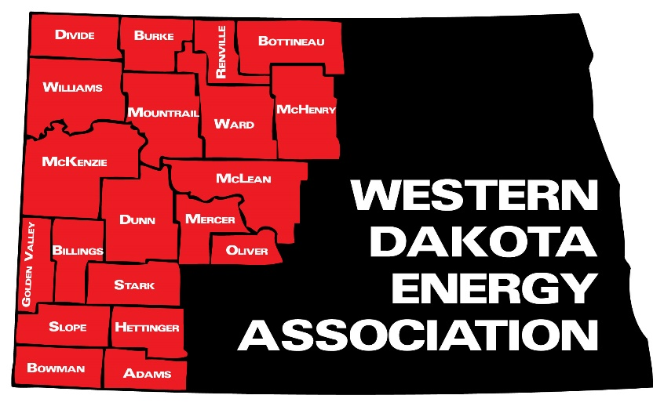
Truck Overweight Permit System
Notes:
Large Truck Permitting on NDACo Agenda
WDEA representatives will participate in a workshop on permitting oversize trucks at next week’s annual meeting of the ND Association of Counties.
The session will also feature an explanation of WDEA’s LoadPass Permits System for regulating the movement of oversize trucks on rural roads. WDEA Executive Director Geoff Simon will explain changes that are happening as a result of a new law enacted by the 2017 Legislature, including ways it enables the association to offer permitting to non-oil producing counties. Permit system operator Janet Sanford will explain benefits to counties if they join the system. And WDEA consultant Brent Bogar will explain enhancements that are being made to the LoadPass Permits system.

Slide 16
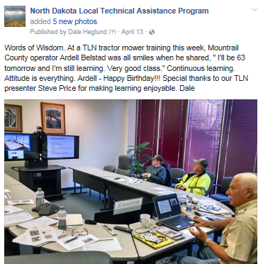
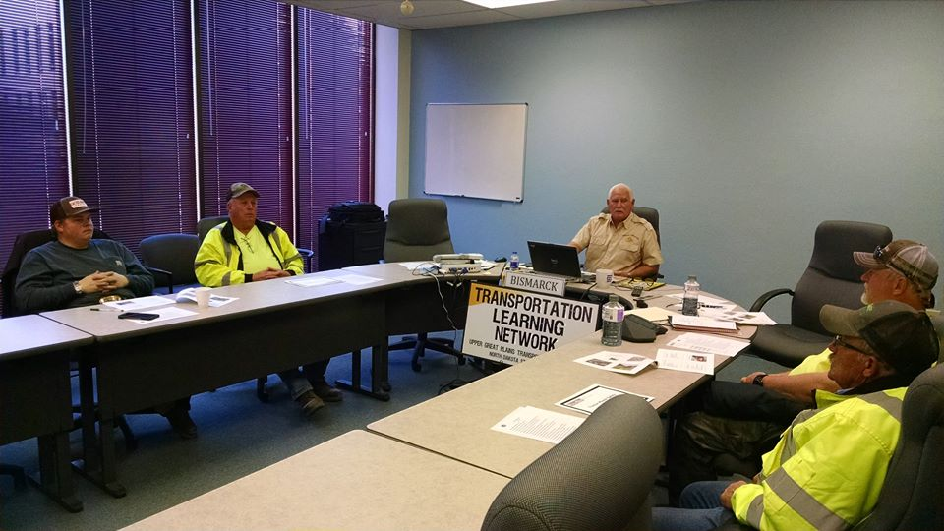
TLN

Slide 17
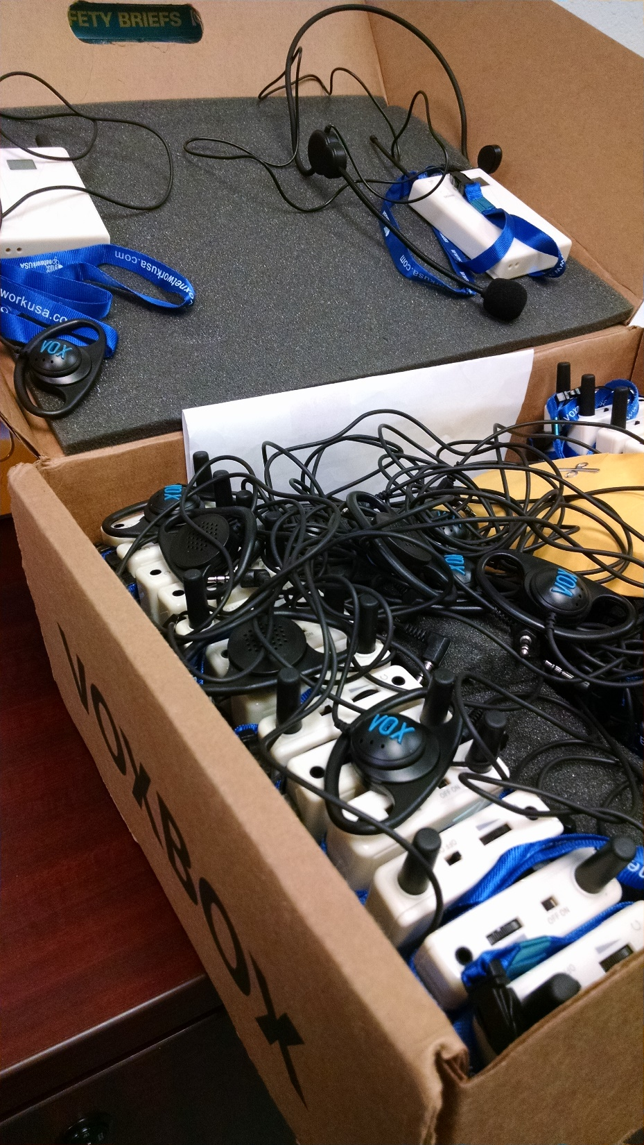
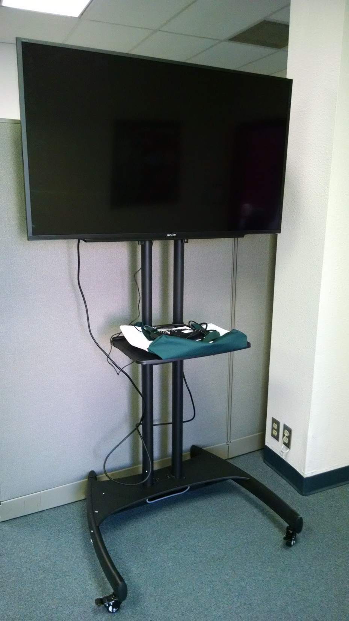
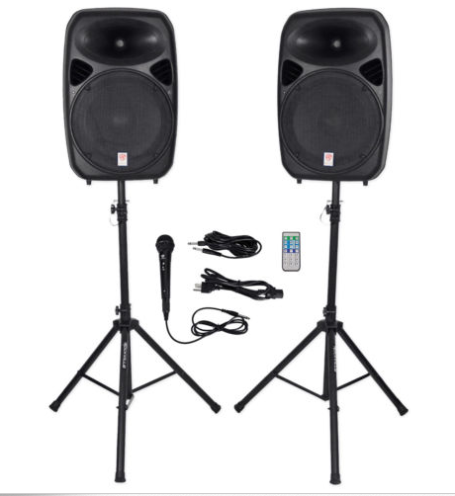
Equipment

Slide 18
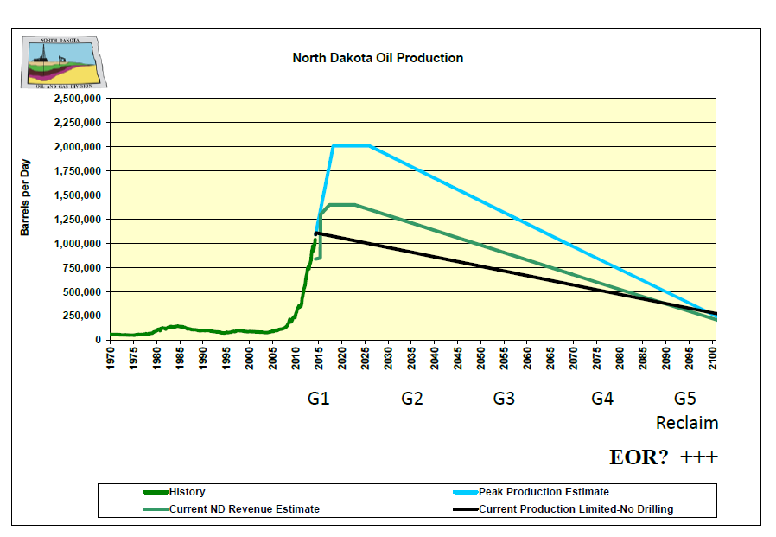
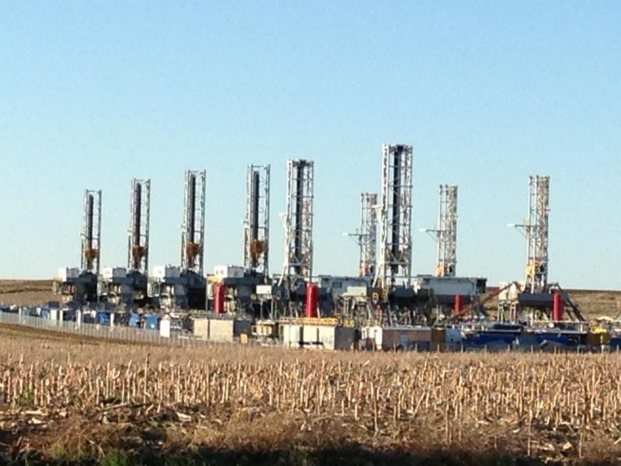

Slide 19
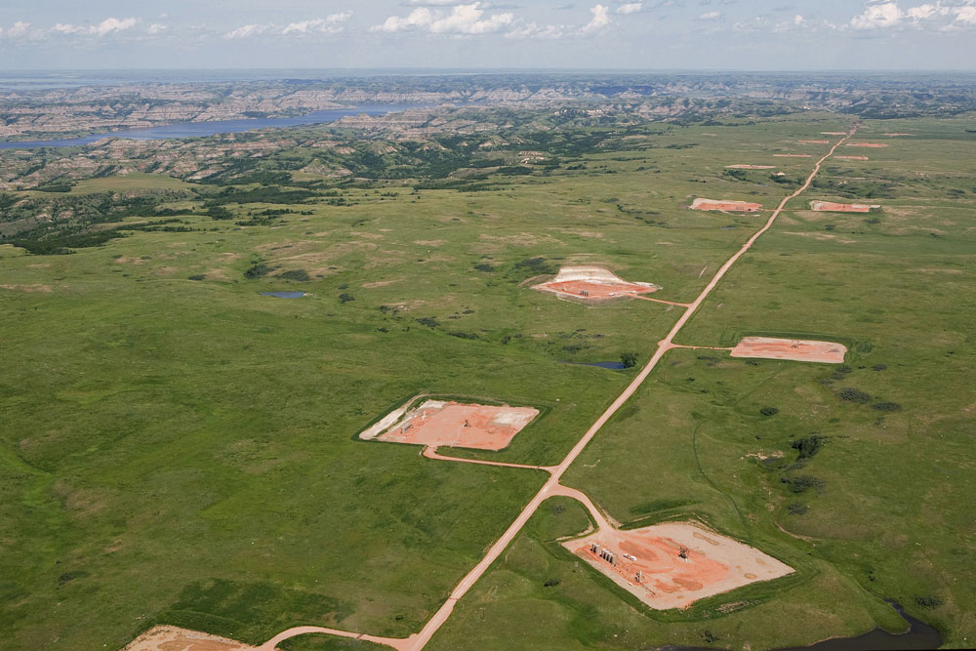

Slide 20
GRIT
Geographic Roadway Inventory Tool
Google map base – free and open to all
Linear referencing – one map system
Simple output – green is good and red is bad
Live data – available to all – public transparency
Asset layers – asphalt, gravel, culverts….
Linked layers – bridge, ….
Asset Management planning – tools to select projects for the future
North Dakota Local Technical Assistance Program

Slide 21
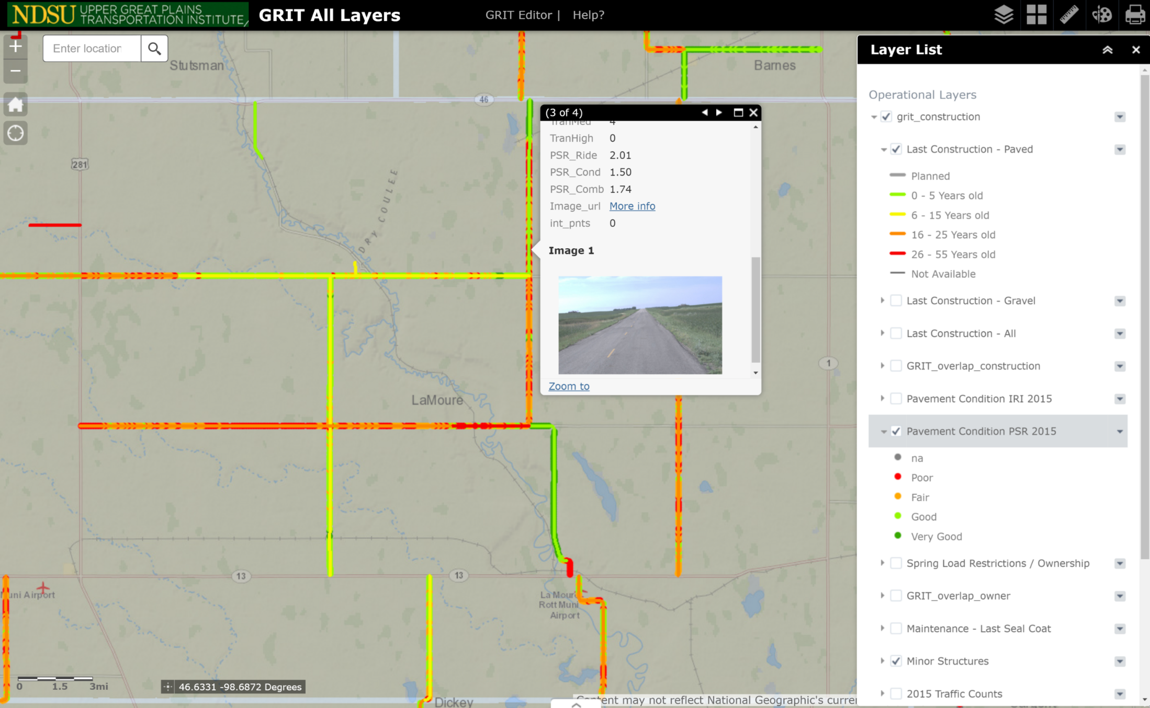
Web map viewer available to all for reviewing and analysis

Slide 22


Slide 23

Level 1
Level 2
Level 3
Certificates of Distinction

Slide 24

NDLTAP Supports Montana Matt

Slide 25
No Boundaries
On a typical map North Dakota has a defined boundary.
North Dakota’s mountain removal project was completed a few years back. With it went North Dakota LTAP’s boundaries.

Slide 26

Thank You!
Sandy Baisch
NDLTAP Expert
701-328-9855
Sandy.baisch@ndsu.edu

Slide 27

Never, ever regret something that made you smile!

