Slide 1
Montana LTAP
Center update
Matt Ulberg, PE
Director

Slide 2
How are we doing?
Program Delivery: FY 2017 ~14% increase in budget resulted in a ~37% increase in program delivery as measured by courses taught and/or number of students reached.

Slide 3
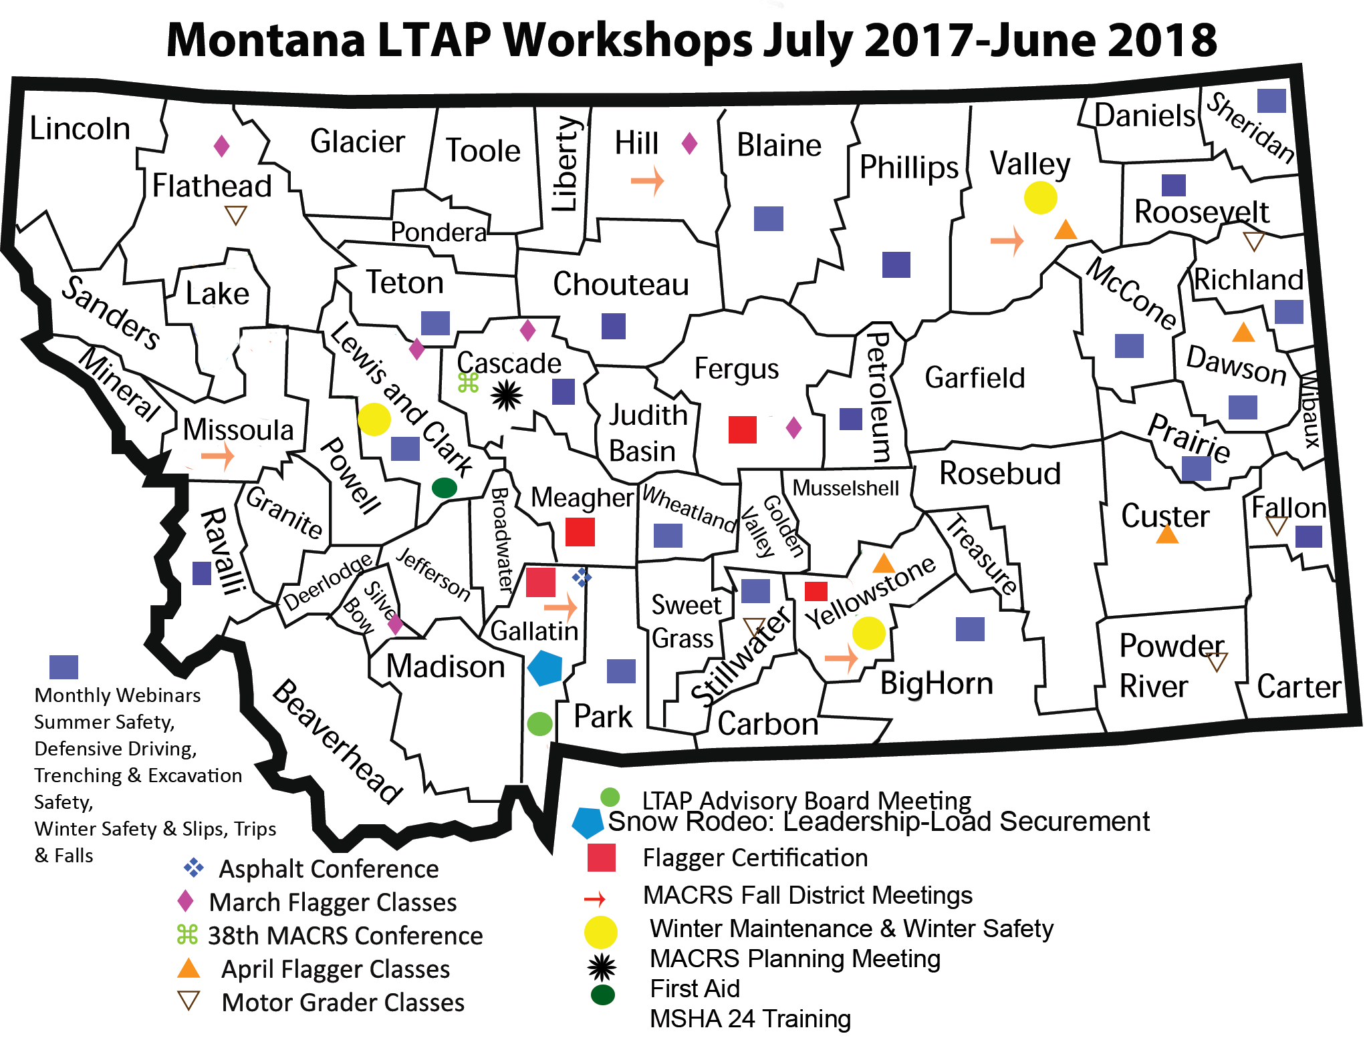

Slide 4
How are we doing?
Hosted 16th Annual Safety Congress January 2018
Continue and expand upon the cooperative program with North Dakota to better serve eastern Montana
Annual MACRS Conference
  2-day conference, split sessions, 275+ attendees, 60+ vendors
  ND LTAP attendance and presentation on “Making Gravel Great Again”

Slide 5
How are we doing?
Solidify partnership with the National Rural Roads Safety Center and leverage the partnership to better serve LTAP customers
Work to improve training program content and delivery coordination and cooperation between LTAP and MDT and FHWA

Slide 6
How are we doing?
Needs Assessment
Encouraging all small urban areas to develop pavement management programs in preparation for applying for federal funding

Slide 7
How are we doing?
We also developed and delivered NEW content for training
  Leadership Styles and Leadership Behaviors Developing a Standard Operating Procedures (SOP) manual – MACRS 2018
  ISD/SSD Training
  Evaluation of Mixed Use on public roads

Slide 8
How are we doing?
Encourage participation in TLN training around the State
Partnered with MDT to promote Highway-rail conference

Slide 9
How are we doing?
Organizational Excellence
Renewed activity and function of Work Zone Traffic Control Committee with MDT/FHWA
Participation in Regional LTAP, NLTAPA, NACE/MACRS

Slide 10
How are we doing?
Program Content - numerous re-worked or renewed presentations including:
HazWopper
MSHA Part 46
MSHA Refresher
OSHA 10
First Aid
Leadership
Flagger, including revised Flagger Tests and training materials
T C Technician
T C Supervisor
Leadership and Leadership Styles
Developing a SOP Manual

Slide 11
How are we doing?
Program and Instruction Quality/Credibility
Renewed Traffic Safety Supervisor, Traffic Control Technical and Flagger Certification program credibility:
  ATSSA Instructor Certification
  MSHA Instructor Certification
  New Exams approved through MDT Committee

Slide 12
Montana LTAP Program
2751 Participants Attended
50+ MT LTAP Training Sessions
242 Training Hours
10,106 Participant Hours

Slide 13
Montana LTAP Program
Monthly Webinars
Monthly LTAP training
Quarterly newsletters
Annual Safety Congress
Annual MACRS Program

Slide 14
Montana LTAP Program
MACRS District Trainings
Quarterly MDT site visits
MDT District Office Visits
County Road Supervisor visits
Technical Assists in various locations and from our office

Slide 15
Montana LTAP Program
Roads Scholar Program:
• 2,750 Participants (+3%)
• Spring 2018: 26 Road Scholars Awarded
• Total Scholars to Date: 355 (+8%)
• Total Road Masters: 15

Slide 16
2017 LTAP Webinars
Backing Up Safety
Summer Survival
Defensive Driving
Trenching Safety
Personal Protective Equipment
Winter Safety
Electrical Safety
Leadership
Winter Maintenance

Slide 17
NEW LTAP Program Content
Leadership when you are not in charge
Leadership Styles and Types of Leaders
Leadership Behaviors (2017/18)
Creating a SOP Manual (MACRS 2017/18)
Creating a Road Supervisors Manual
(in progress)

Slide 19
Where are we headed?
Leveraging Increased in-house capabilities
More use of developed resources and internet-based trainings available
More digital exchange
Less use of lending library and VHS mailings

Slide 20
Where are we headed?
Partnering
National LVR Conference Support
Kalispell, Fall 2019 –this is a BIG Deal!
MDT TLN Network Courses
Rural Safety Center Trainings

Slide 21
Montana LTAP Program
What has Changed?
Internal Training expertise
Shawna Page - Professional Trainer
  LTAP is No longer a Director-only instruction program
Training Program Credibility/Certification
Program Content

Slide 22
Montana LTAP Program
What has Changed?
Partnering
WTI Transportation Centers
  deliver on the “Tech Transfer” portion of our mission..
Partnership with ND and SD LTAPs
TLN via MDT
Vendors participation in trainings

Slide 23
Montana LTAP Program
What has Changed?
External training expertise
  Equipment training and operations
Internal Expertise - Certifications
  MSHA Part 46
  ATSSA WZ Safety
  ATSSA WZ Tech
  Medical/First Aid
  HAZMAT/HAZWopper

Slide 24
Montana LTAP Program
Opportunities?
TLN Network Focus areas:
Civil Rights
Construction
Design
Environmental
Maintenance
Materials
Planning
Professional Development
Safety/Work Zone

Slide 25
Montana LTAP Program
What needs work? Relationships and Local attention
Solution: Local Delivery program
Counties expect to see me (Director)
  56 Counties and County Seats
Taking the tech to the people!
Leave-behind packages with easy to follow guide for resources
  Personal contact

Slide 26
Montana LTAP Program
What needs work?
Improve relationship and Coordination with MDT/FHWA
RRC Participation
Pooled-Fund
MDT Highway Rail Conference

Slide 27
Montana LTAP Program
What needs work?
MSU - transfer of research results
WTI Center Coordination and Training Cooperation
Cooperative trainings opportunities with MDT Districts

Slide 28
Montana LTAP Program
What needs work?
Coordination and Communication
Service to Cities and Towns
Role with APWA
Role with MDT
NPS/USFS/BLM

Slide 29

Montana LTAP Program highlights

Slide 30
Montana LTAP
Safety Certification Program
Update on cooperative efforts to develop a Certification program for Transportation Safety, referred to as a Local Road Safety Certificate in cooperation with WTI’s National Center for Rural Road Safety and NACE.

Slide 31

Montana LTAP
In 2017 the following occurred:
The National Center for Rural Road Safety (Safety Center) put together a report entitled “Development Materials for a Local Maintenance Personnel Rural Road Safety Recognition Program.”
Also, the National Association of County Engineers (NACE) began laying the groundwork for a Local Road Safety Certificate.

Slide 32
Local Road Safety Certificate
Also in 2017, the West Region Transportation Workforce Center (WRTWC) received a grant to work on developing a national implementation plan for transportation safety career pathways.

Slide 33
Local Road Safety Certificate
The WRTWC conducted research and worked with an advisory group over the first year of the project to understand needs of the profession.
These were the safety training priorities:
road construction
maintenance
engineering and design staff

Slide 34
Local Road Safety Certificate
Also, the National Association of County Engineers (NACE) began laying the groundwork for a Local Road Safety Certificate.
You can see that there are many parallel efforts here….

Slide 35
Local Road Safety Certificate
At the end of 2017, both NACE and WRTWC approached the Safety Center about the need for safety training module development.
In 2018, the three entities began working together towards the same goal of developing a Local Road Safety Certificate. The newest version of the framework incorporates/melds the previous work done by all three entities.

Slide 36
Local Road Safety Certificate
VISION
  The vision (as laid out by NACE) is to “eliminate fatal and serious crashes from all public roads.”
MISSION
  The mission (as laid out by NACE) is “promoting safety through professional development of local road officials utilizing a comprehensive safety educational initiative.”

Slide 37
Local Road Safety Certificate
OBJECTIVE
The objective (as laid out by NACE) is to ensure that
“the core competencies for local road officials and safety professionals are intended to provide the foundation of baseline knowledge for safety education and professional development. The competencies represent the minimum set of core knowledge, skills, and abilities to begin functioning effectively in the local road safety field.”

Slide 38
Local Road Safety Certificate
The audience is Local road officials focused on,
  Road design
  Operations
  Engineering
  Construction
  Maintenance
  Management

Slide 39
Local Road Safety Certificate
The framework is split into 5 safety career pathways:
  Leadership
  Planning, Design, Operations & Data Analysis
  Construction & Maintenance
  Public Health
  Law Enforcement

Slide 40
Local Road Safety Certificate
Next steps are:
  A survey of NACE members to ensure training topics are correctly categorized.
  A detailed template for each training title including: brief description, mapping back to the core competencies, learning objectives, and existing trainings that can be used/modified

Slide 41
Local Road Safety Certificate
Next steps are:
  Identifying or developing a set of training courses for each career path outlined above.
  Developing a learning management system so personnel can track coursework taken and completed towards attainment of the certificate.
  Identifying opportunities to coordinate with degree programs
    (like the Road Maintenance Associates Degree program being developed by CDOT) to offer course credit

Slide 42
Text
Text
Text
Text
  Text

Slide 43
Text
Text
Text
Text
  Text

Slide 44
Questions?
Matt Ulberg, PE
Montana LTAP
Montana State University
PO Box 173910
Bozeman, MT 59717
1-800-541-6671

