Slide 1
Local Highway Technical Assistance Council
Laila Kral, PE
Deputy Administrator
Advocate. Support. Train.

Slide 2

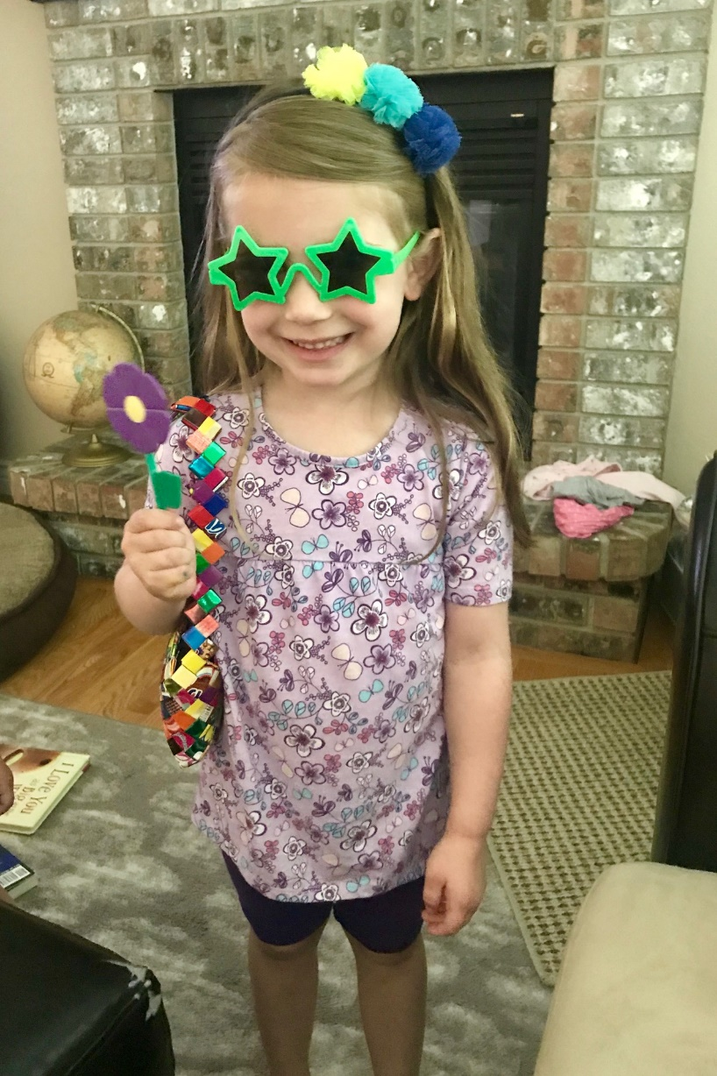
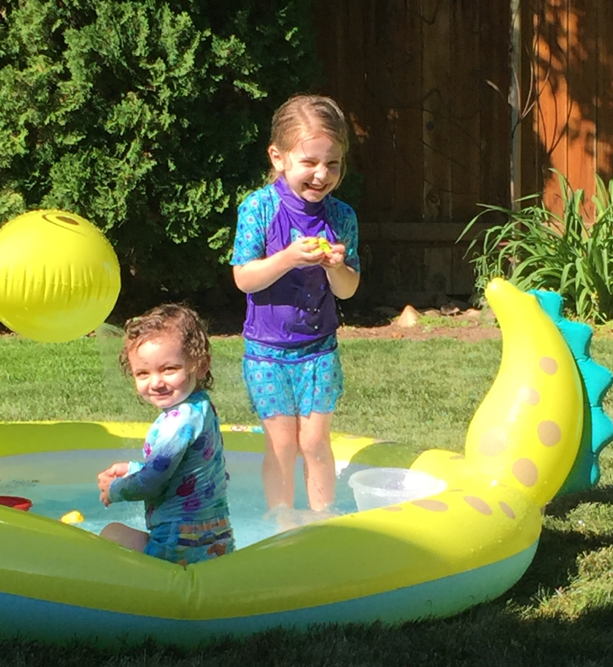
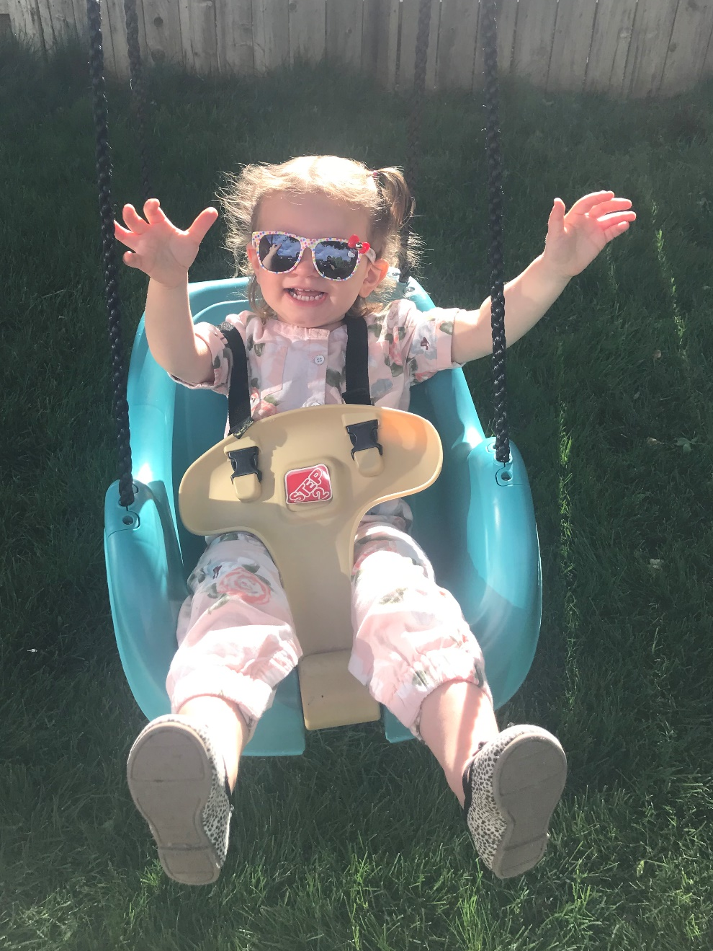

Slide 3
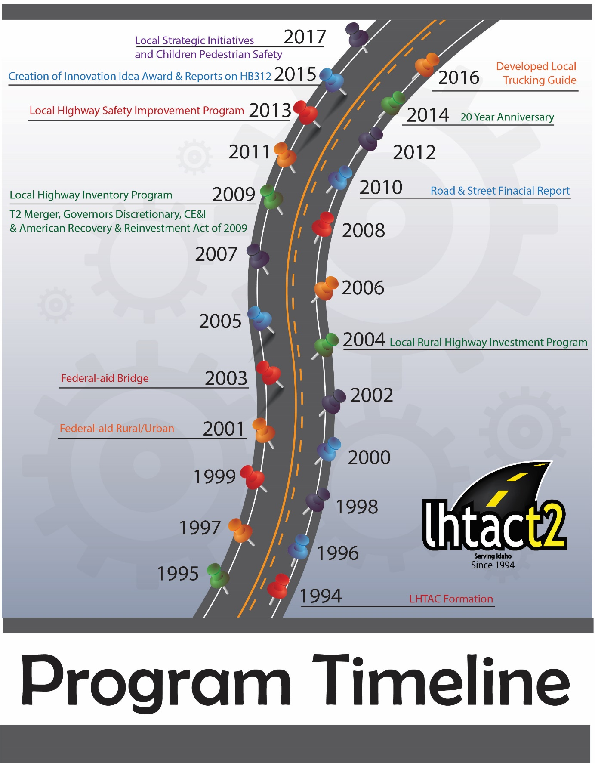

What is LHTAC?
Local Highway Technical Assistance Council
Created by the Idaho Legislature in 1994
Tech Assistance
Funding Administration
Training

Slide 4
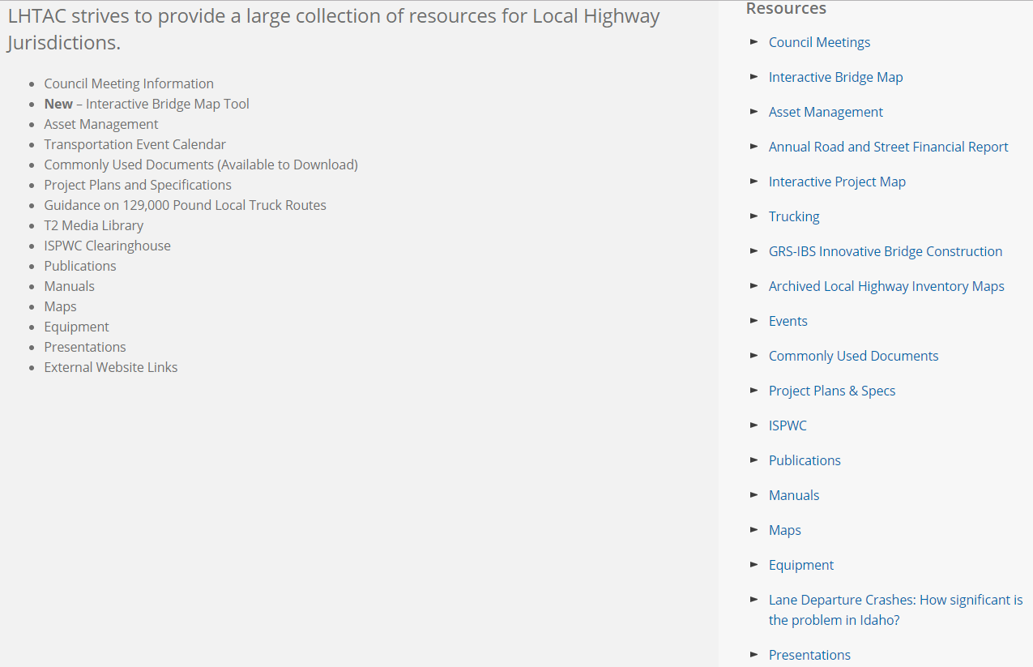
Some of our Resources

Slide 5
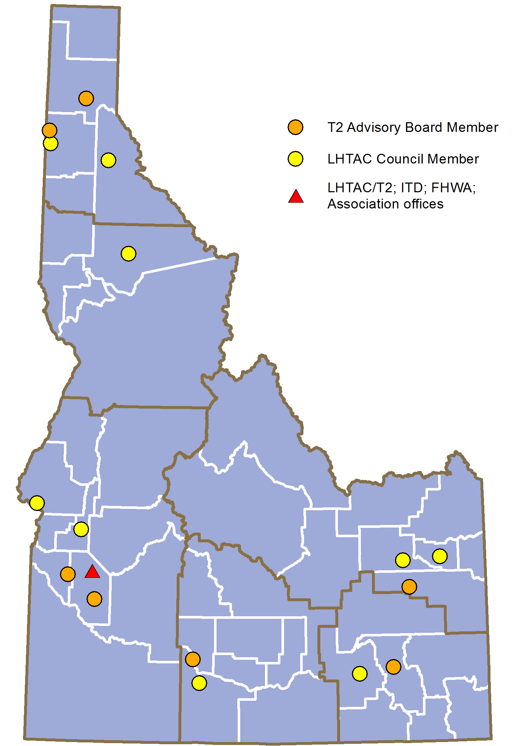
Council and Advisory Board

Slide 6
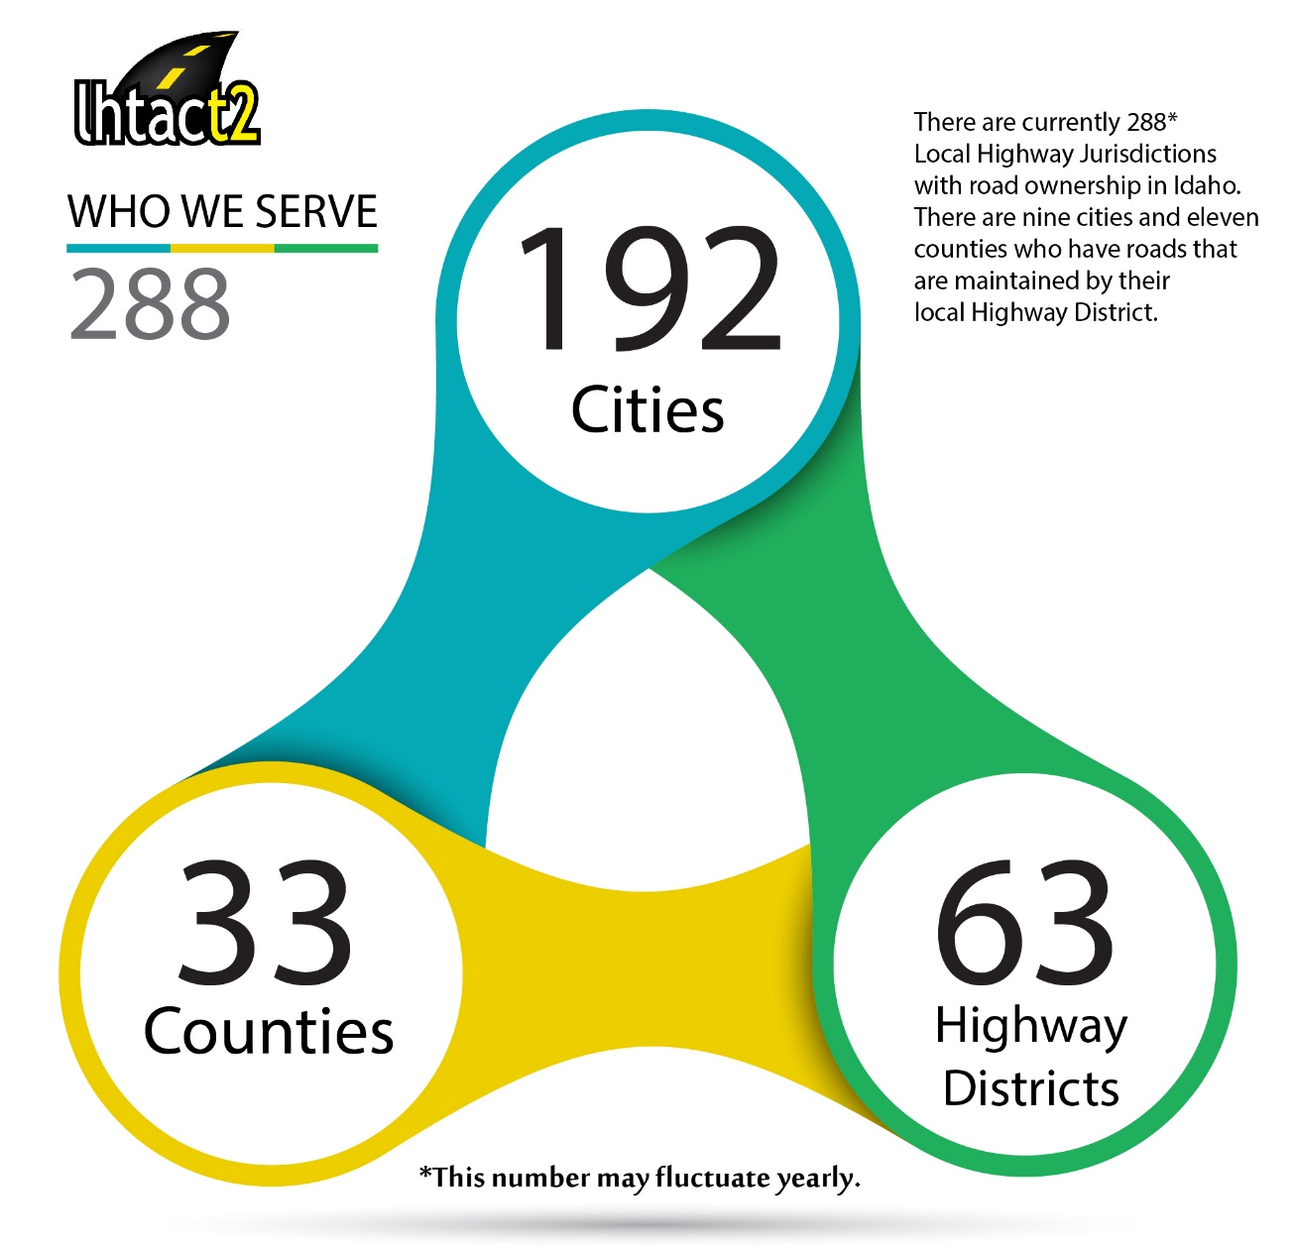
Who we serve

Slide 7
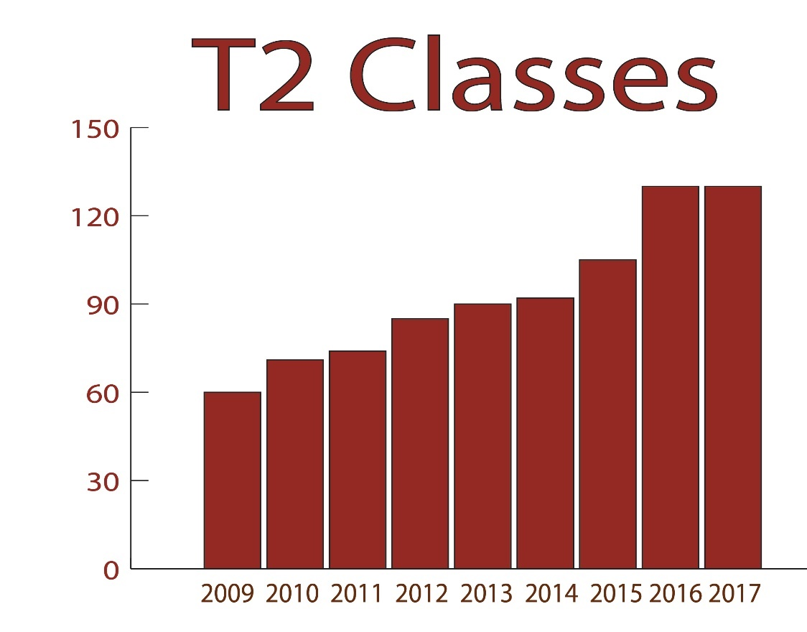
2017 Courses
Maintain # of classes held
2018 projecting slight decrease
Less availability of trainers
Saturation?
New program should help

Slide 8
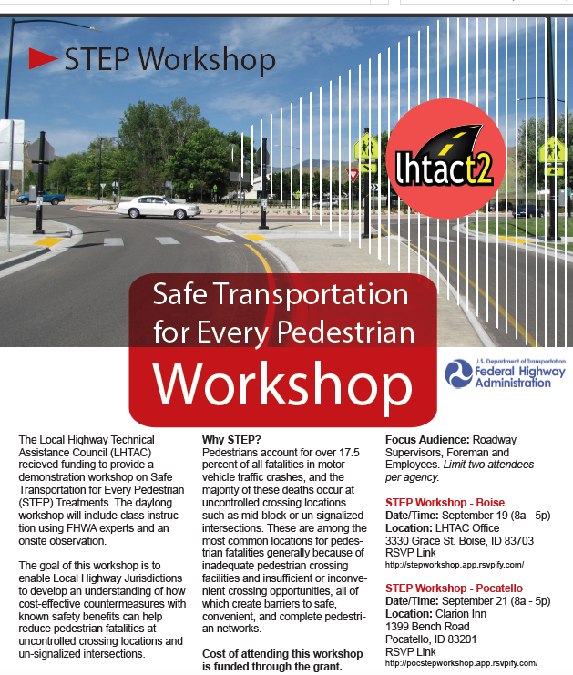
2017 Special Courses
Flagger Instructor Training Course
Students paid for class
LHTAC paid for hotel
13 attendees (11 local agencies)
Safe Transportation for Every Pedestrian
Received STIC grant
Two workshops in September in Southern Idaho
Recently held another workshop to tie into Walk/Bike Summit
Designating Truck Routes
Special course developed by Resource Center
Rescheduled from original date of Spring 2017 to Fall 2017

Slide 9
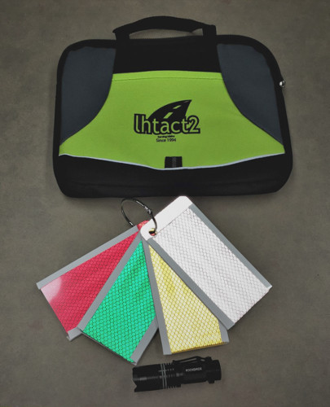
2017 Other Highlights
Increased presence at Boise Safety Fest
Awarded STIC funding
Data Driven Safety Analysis
Safe Transportation for Every Pedestrian
LRSP Workshop
Hosted by FHWA
~30 attendees
Made/distributed 164 Retroreflectivity Kits

Slide 10

Provide the best and most efficient assistance to every local highway jurisdiction in Idaho
Advocate. Support. Train.
lhtac@lhtac.org
www.LHTAC.org
3330 Grace Street, Boise, ID 83703

Slide 11
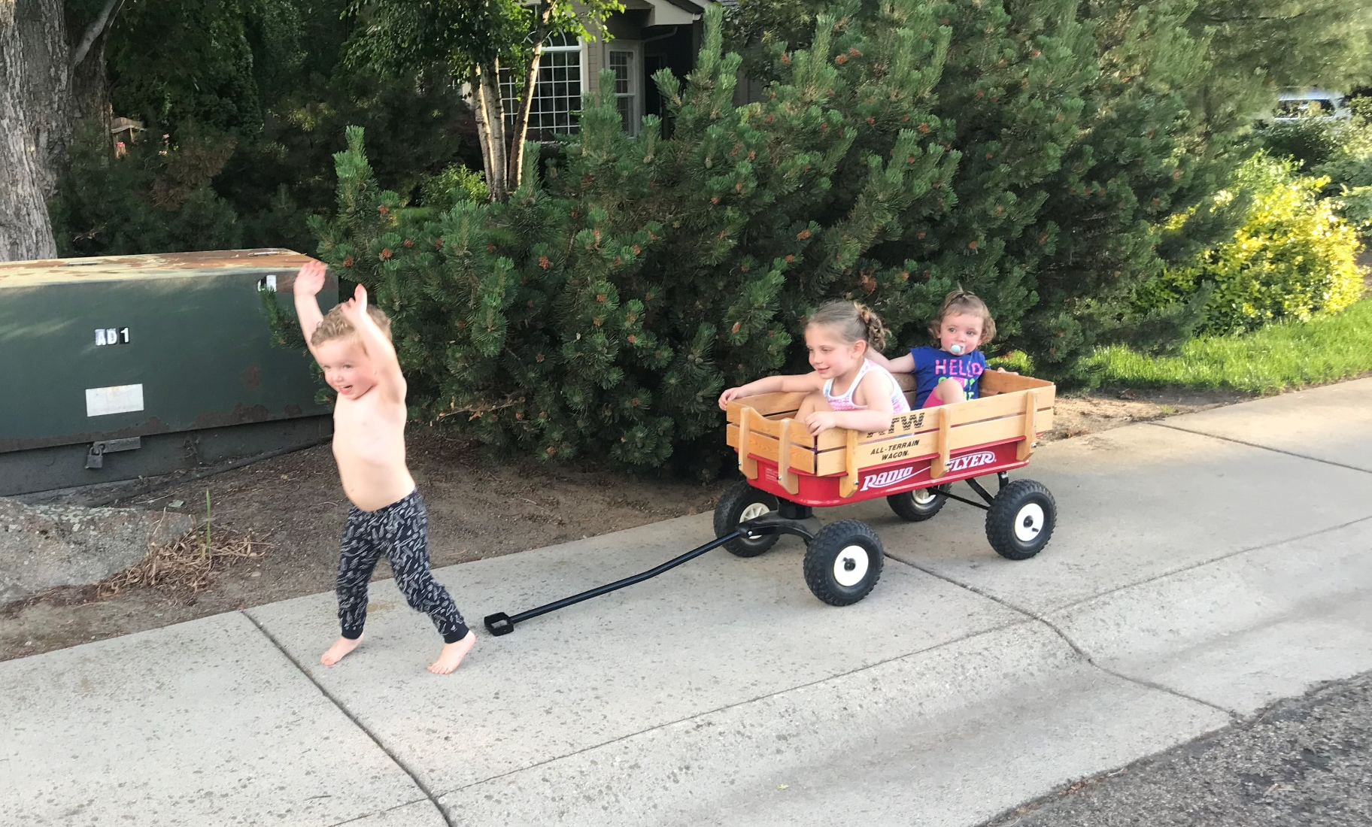
See you next time!

