Slide 1

ASAP Efforts in Florida

Slide 2

ASAP Efforts in Florida
Retroreflectometer – 2007
Roundabout PSA – 2012
RSA for CTSTs – 2014
Safety Edge Peer Exchange – 2014
Intersection Safety for Rural Counties - 2014

Slide 3
Retroreflectometer
2007

Slide 4
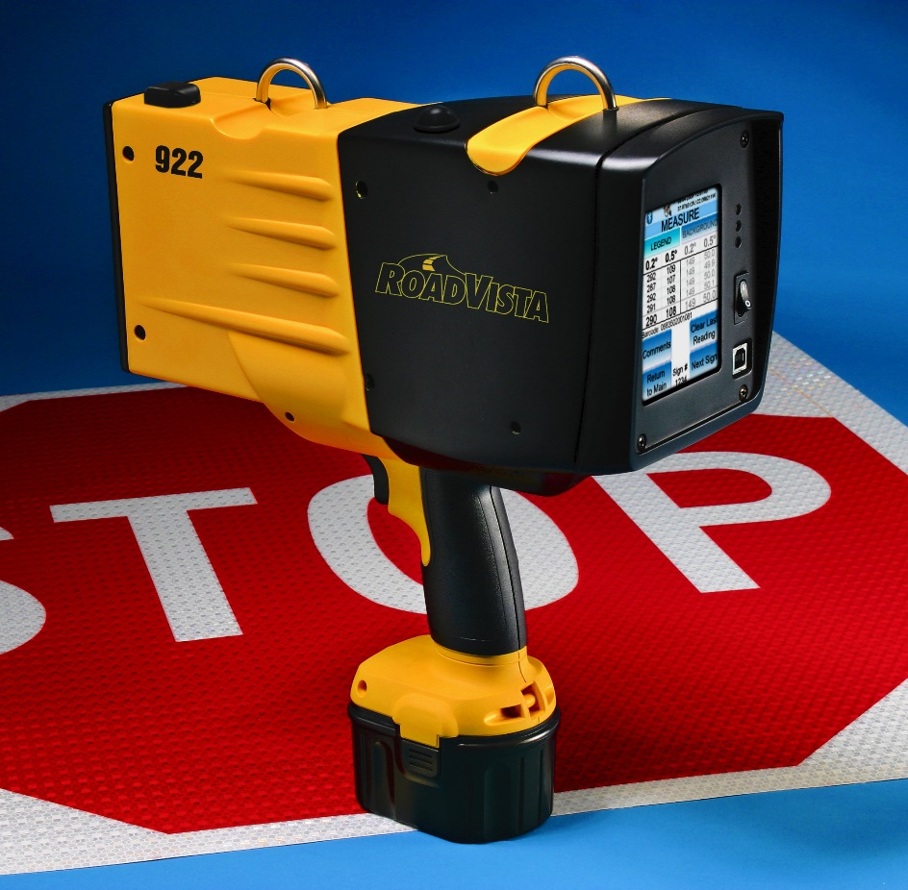
Retroreflectometer
Retro loan program
Training
RoadVista 922
$9,925.00

Slide 5
Retro Loan Program
Over 15 Local Agencies (multiple times)
Loaned for 2 – 3 weeks
Repaired 3 times
Upgraded twice
City of Atlantic
Beach
Notes:
SUCCESS STORY
City of Atlantic Beach
Said that it has saved the City over $27,000. They are on the coast and before they started using our retro loan program, they thought they would have to replace many more of their signs than they found they really had to. They have hired a part-time employee who borrows our retro and does a certain number of signs for the loan period. They then take the next few months while it is at other agencies to organize the data received from the retro and then they borrow it again.

Slide 6
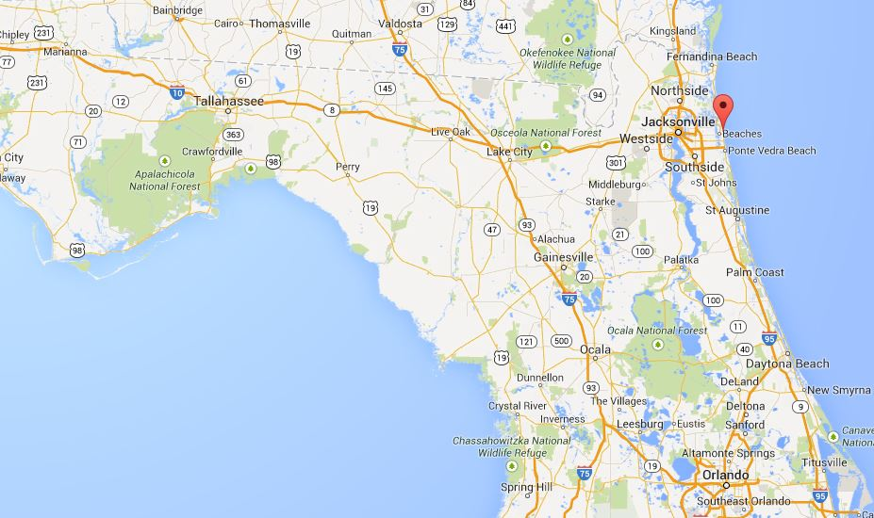
City of Atlantic Beach

Slide 7
Roundabout PSA
2012

Slide 8
Roundabout PSA
Increase in roundabouts in Florida
FHWA Countermeasure
Create a Public Service Announcement
Video
Audio (radio)
UF College of Journalism and Communication
Website (1 year)

Slide 9
Process
Script
Shooting
Production
Distribution
~27 radio/TV stations
Social Media (YouTube, Facebook)
LTAP Clearinghouse
Notes:
~600 views on YouTube

Slide 10
Final Product
http://www.youtube.com/watch?v=Rkd0G8ZHxLM

Slide 11
Rural County Training
2014

Slide 12

RSA for CTSTs
Community Traffic Safety Teams
Shortened 1-day version
Focus on rural counties
Intersection/Lane Departure crash statistics
Notes:
CTSTs
locally based groups of highway safety advocates
local city, county, state, and occasionally federal agencies, private industry and local citizens
Multi-jurisdictional/multi-disciplinary

Slide 13
Intersection Safety Training for Rural Counties
Intersection Safety
Three course offerings to rural counties/small communities
Countermeasures
Roundabouts
Pedestrian Hybrid Beacons
Signal Backplates with Retroreflective Borders

Slide 14
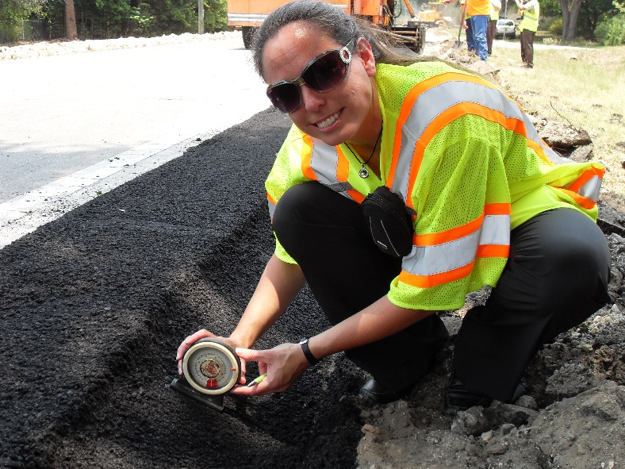
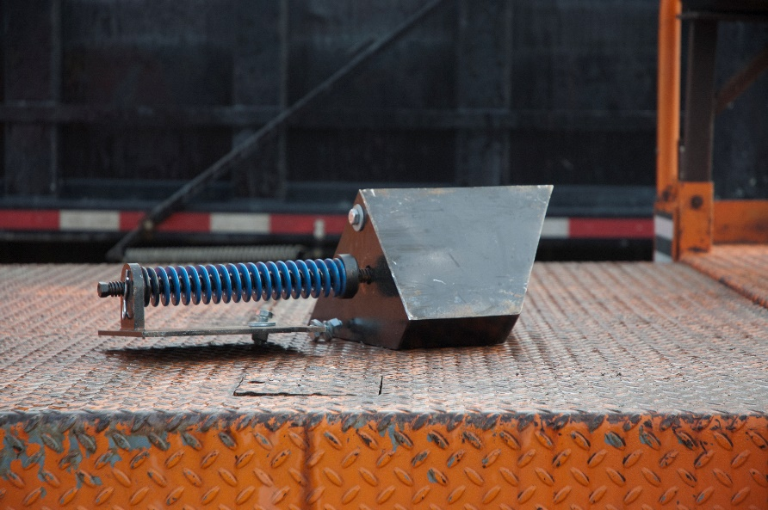
Safety Edge Peer Exchange
25 participants
FDOT
City/County Agencies
FHWA
Universities
Private Companies
Benefits/challenges of implementation

Slide 15
Questions?
Jaime Carreon
Project Manager
Florida Transportation Technology Transfer (T2) Center
jacarreon@ufl.edu
352.273.1697

