Slide 1
California LTAP
2018 Regional Meeting Update
Pauline Cueva
CA DOT
LTAP Program Director
Tracy Coan
Sacramento State CCE
LTAP Program Manager
June 5, 2018

Slide 2
CA Local Agencies
600+ Local agencies (cities, counties, regional agencies)
200+ Caltrans Local Assistance personnel to support local agencies in federal aid
12 District with 5 to 15 Caltrans DLA staff
  Safety, Active Transportation, DBE, Bridge/Structures, ROW, training solely for local agencies
Local Agency contact directed to district DLA staff
Oversee 1 billion per year in federal aid

Slide 3
Combined Effort
California’s LTAP Program is directed and co-managed by CA DOT, Division of Local Assistance
  Pauline Cueva
Facilitation, logistics, and co-management by Sacramento State, College of Continuing Education
  Babette Jimenez – Sacramento State Contract Manager
  Tracy Coan - Program Manager
  Stephanie Olarte - Program Assistant

Slide 4
CA LTAP Staff
Only….
Pauline – 50%
Tracy – 50%
  Tracy’s Assistant Stephanie - 65%
Total of 3 personnel working part-time on LTAP contract

Slide 5
Hitting Our Stride
Pauline – 2 ½ years with LTAP
Tracy – 4 years with LTAP, but 2 in a program management role
LTAP meetings, conferences, group emails, webinars are extremely beneficial

Slide 6
Marketing and outreach

Slide 7
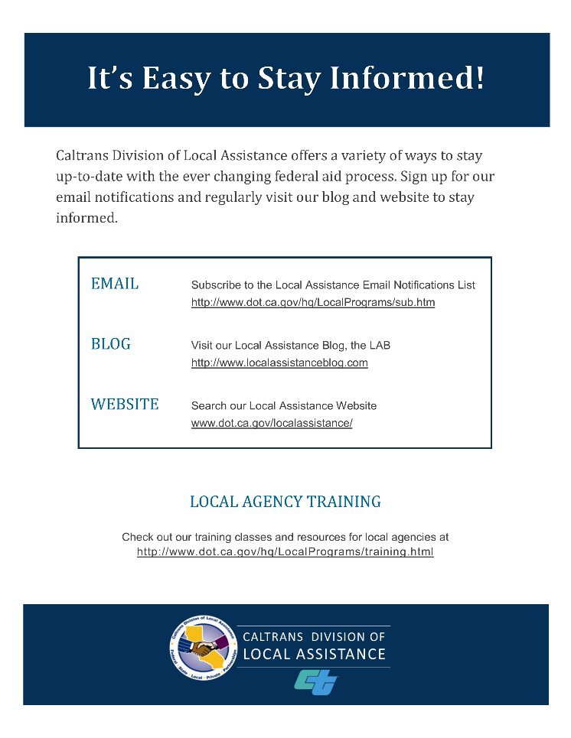
Marketing and Outreach
Branding (Logo, Email, Blog, Presentations, DLA)
Email Notification Subscription List
Blog and Blog Summary
Word of Mouth
  Tell Everyone, Everywhere, Every Time
  Fliers

Slide 8








New CA LTAP Logo

Slide 9
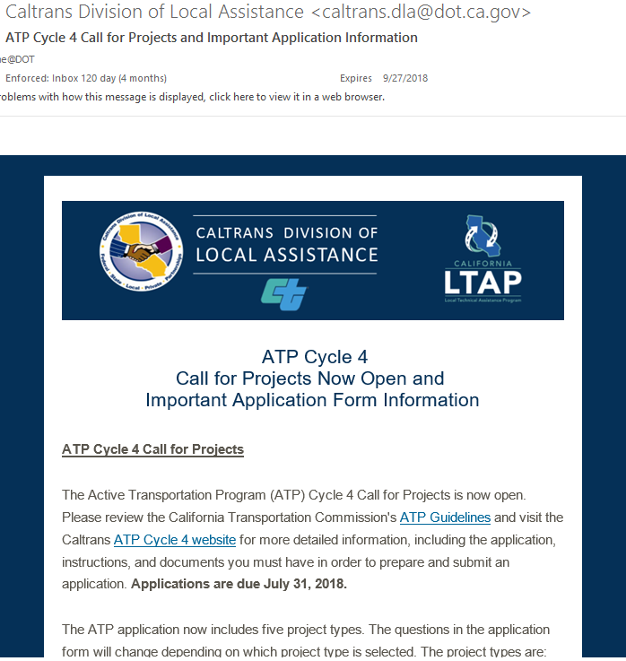
Outreach – Email Notifications List
Subscribe to DLA
Email List
Weekly Emails
Over 4,300 Local Agency, DOT, FHWA, Consultants
25 to 40% Open Rate
Praise from Local Agencies

Slide 10
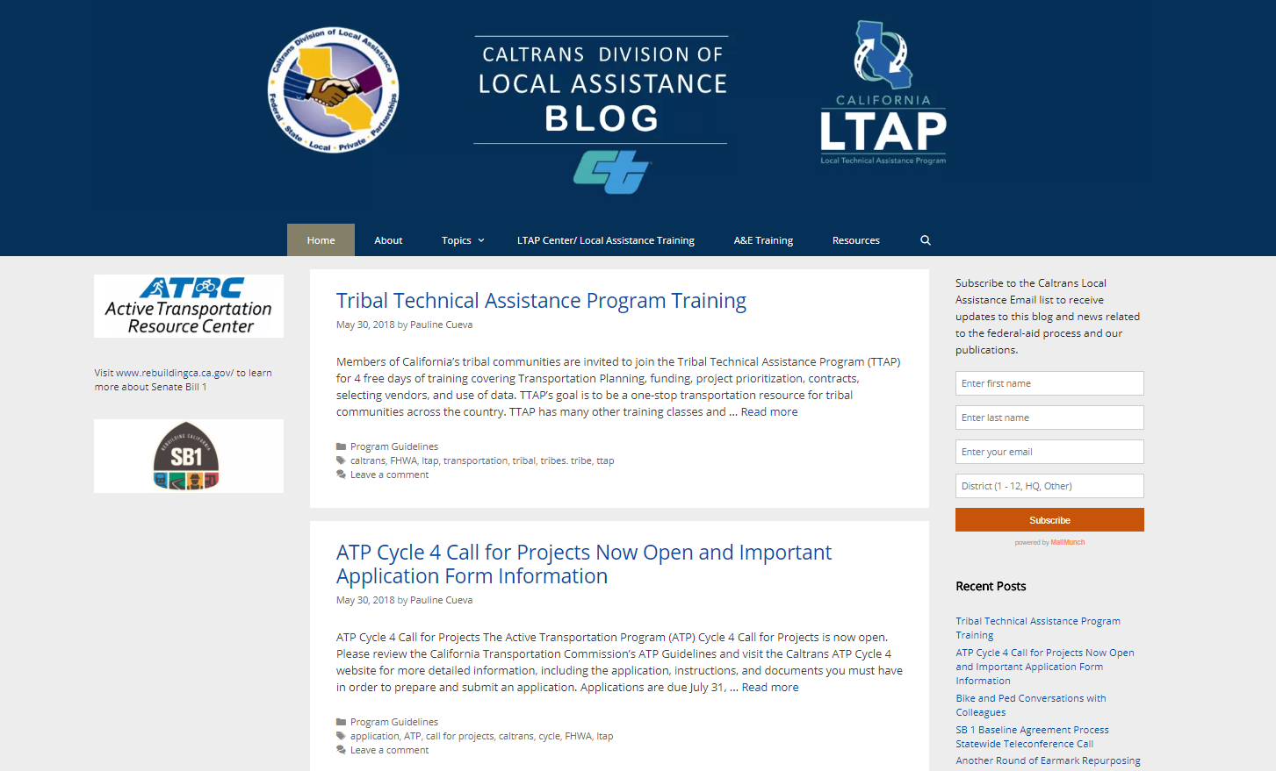
Outreach - Blog
Local Assistance Blog
Bi-Weekly Summaries

Slide 11
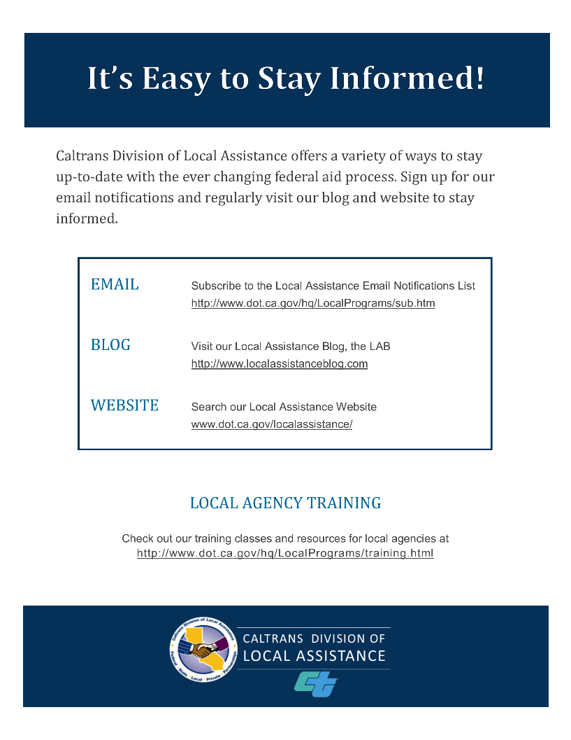
Outreach – Word of Mouth
Word of Mouth
  Tell Everyone Everywhere Every time
    Trainings
    Webinars
    Meetings
    DOT Staff
  Fliers
    Meetings
    Training / Binders

Slide 12
Our Deliveries

Slide 13
Continue to Deliver
6 Resident Engineers Academy (4 days)
  220 total participants
5 – 6 Federal Aid Essentials (5 days)
  255 total participants
2-3 a year
  A&E
  DBE

Slide 14
Continue to Deliver (Continued)
60 subsidized classes for Local Agencies through UC Berkeley, Institute of Transportation Studies, Tech Transfer
Equipment Loan Program
  2 Retroreflectometers
Facilitation of Local Agency and CA DOT Local Assistance meetings
Open Houses/Equipment Demonstrations
  High Friction Surface Treatment (HFST)
  Safety-Edge
  Roadway Safety System Design, Inspection and Maintenance

Slide 15
New Training for LTAP in 2017/2018
24 In-person A&E ½ day classes within 3 weeks
2-3 Labor Compliance classes
4-5 Recorded webinars (HSIP, HBP, A&E)
4 In-person A&E On-Call Classes
6 Video Shorts
4 A&E Voice-Over PPT Training Videos
NHI Course (Program Funding)

Slide 16
New Involvement for LTAP in 2017/2018
ATRC
HSIP STIC Program
Bridge STIC Program
Local Road Safety Program
Peer-to-Peer Exchanges

Slide 17
BIG Plans

Slide 18
In The Works
New CA LTAP website
  More comprehensive
  More resource links and tools
More Equipment
  Bike & Ped Counters
Technical Assistance Offering (Contract)
  Application
  Program
  Forms

Slide 19
In The Works (Continued)
Pavement, Construction Classes
Increased Local Agency and LTAP Involvement
2019 Survey/Needs Assessment
Safety Peer Exchange
Local Road Safety Pilot Program

Slide 20
Thank you!
Questions?

