Slide 1
Colorado LTAP Successes & Challenges
Renée railsback, Colorado LTAP

Slide 2
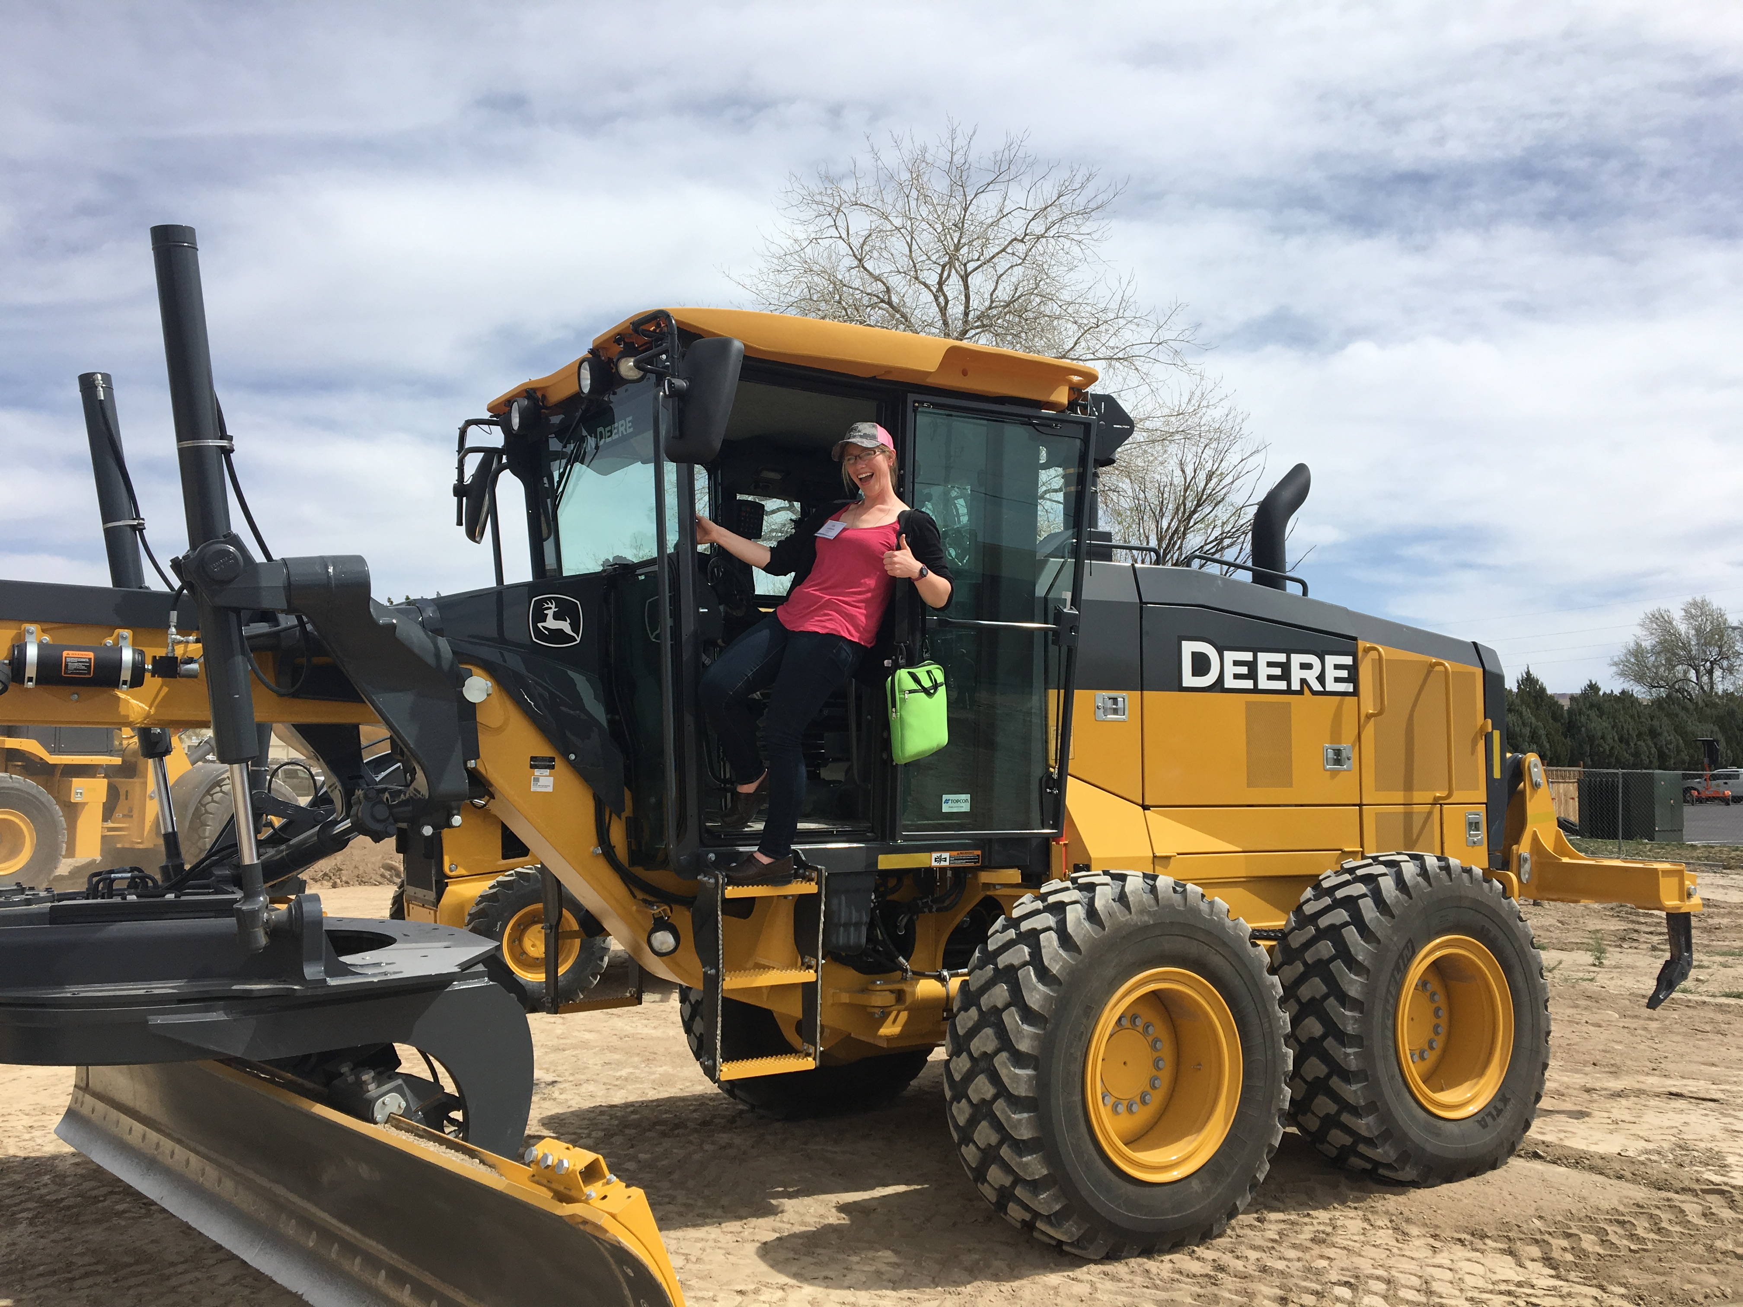
Big Changes…..
Welcome
Liz!

Slide 3

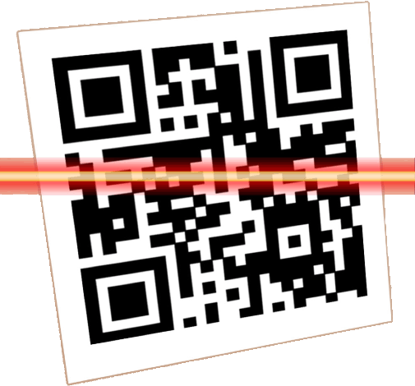
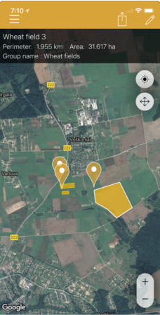
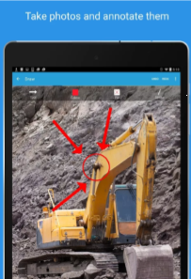
Mobile Apps
Asphalt Pavement Cooling Tool
Trench/Excavation Slope Calculator
Field Quantities Calculator
Work Zone Safety Suite
iAuditor Inspection Forms
Things to Consider before Purchasing
Notes:
There are so many APPS out there these days.
I’m not saying these are the BEST –
but these are APPs that I know are being used by LPAs and DOTs across the country.
**All of these presented - have a FREE version.
HANDOUTS – If you have not done so already (because I hadn’t) –
Download a free (Quick Response) QR Code Reader to your mobile devices to easily access all the sites on my handouts!
Mine is called “QR Sanner” App

Slide 4


ATSSA Work Zone Safety Application Suite
Set up temporary traffic control areas
Quickly determine minimum # and device spacing for
merging, shifting, shoulder, or flagger ops.
Customize your results to incorporate local standards.
Learn best practices for stationary lane closures
and short duration operations.
Notes:
ATSSA Work Zone Safety Suite
FREE
(Available on iTunes & Google Play)
ATSSA developed in collaboration with FHWA…
to facilitate proper work zone layout and setup as well as act as a reference manual for work zone attributes and safety procedures.
BULLETS:
Set up Temporary Traffic Control Areas
Quickly determine both minimum device spacing and minimum number of devices needed for merging, shifting, shoulder, or flagger operations.
Customize your results to incorporate local standards.
Learn about and apply best practices for stationary lane closures and short duration operations.

Slide 5
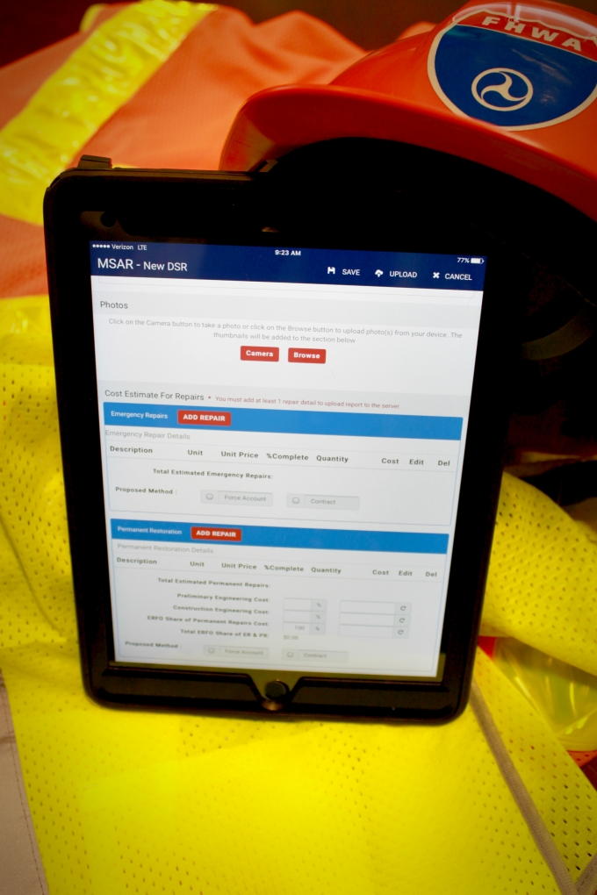
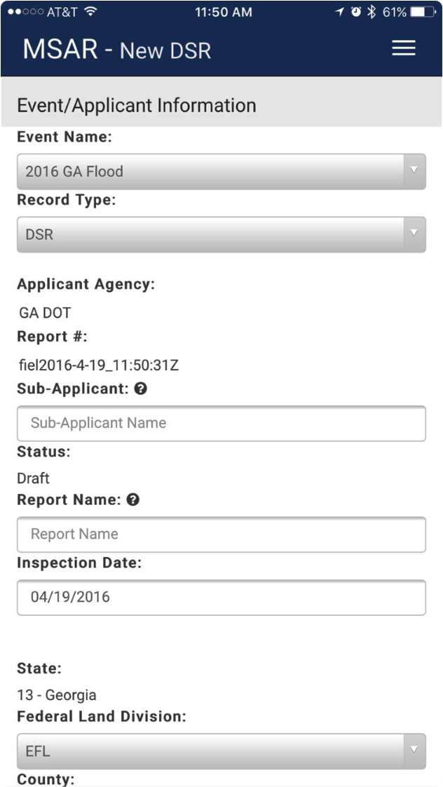
“Mobile Solution for Assessment and Reporting”
Innovative App to Recover Quickly After Natural Disasters
Simplifies laborious time-consuming data collection
Eliminate paper surveys/inspection reports
Damage photos pinpointed on map
Data entered is compiled by state
offices for FHWA emergency relief
Notes:
Every minute matters when making damage assessments in the aftermath of a disaster.
Technology saves time and can be critical to efforts to get roads and bridges re-opened.
SO – FHWA developed this innovative app
to replace detailed, time-consuming paper surveys and inspection reports on the damage
that are required under the agency’s Emergency Relief Programs
BULLETS:
Innovative App to Recover Quickly After Natural Disasters
Simplifies laborious time-consuming data collection
Eliminate paper surveys/inspection reports
Damage photos pinpointed on map
Data entered later compiled by state offices for FHWA emergency relief coordinators
EXAMPLE:
Put to the test after Hurricanes in Houston – TexDOT used this MSAR APP
On average, site inspections took 30 minutes – making possible the completion of damage assessments for more than 500 sites in 3 weeks.
For Hurricane Harvey alone, FHWA and TXDOT saved an estimated 17,000 hours of staff time

Slide 6
Associate of Applied Science Degree
Highway Maintenance Management
Front Range Community College*
60 credit hours required
    Required General Education courses (15-17 credits)
    Required Management courses (15 credits)
    * Required Highway Maintenance and Operations courses (15 credits)
    * Elective Highway Maintenance and Operations courses (13-15 credits)
“Prior Learning Assessment” - LTAP Roads Scholars & APWA PWI
APWA Reporter Article, June

Slide 7
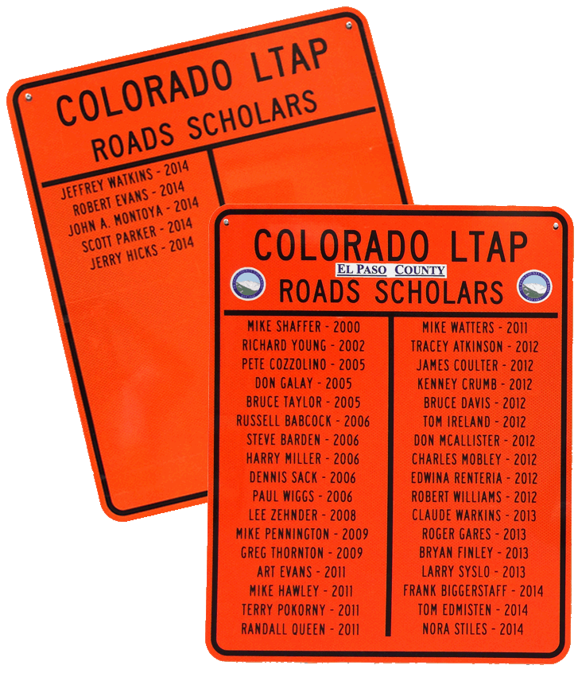
2017 LTAP Center Training
Roads Scholar I
    4 Cores & 5 Electives
Roads Scholar II: Road Master
    Safety; Infrastructure Mgmt; Environment; Technical Skills
    Graduates awarded at APWA Awards Luncheon
Supervisory Sills & Development Program
    9 set required courses
70 Classes; 1850 Attendees (68% FR + 32% WS)
    Best Practices for Crack Sealing & Wide Crack Repair
    Road Applications of Tire Derived Aggregate (CDPHE)
    Short Span Steel Bridges (Alliance)
    Guardrail Maintenance & Installation

Slide 8
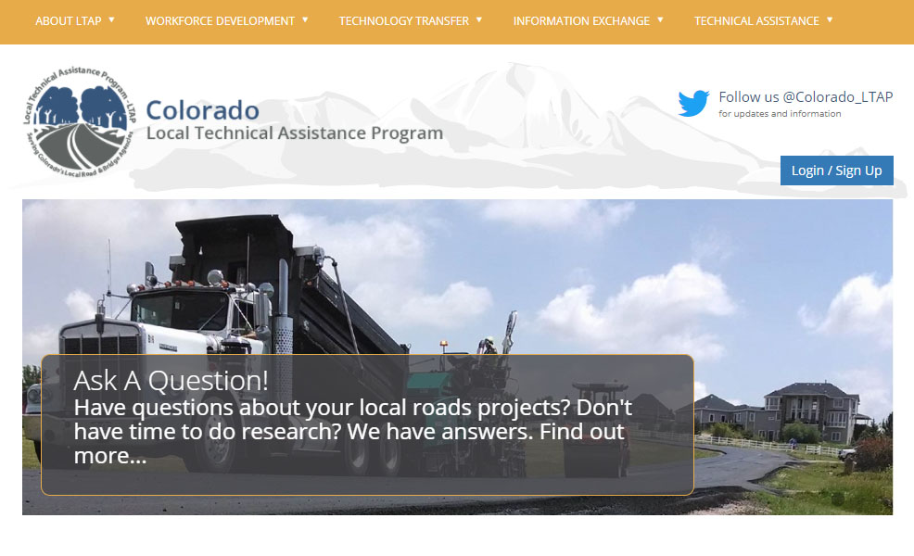
LTAP Resources on the Web
www.ColoradoLTAP.org
Notes:
So I bet you’re asking yourself – “Where can I access these great resources??”
New Website…..

Slide 9
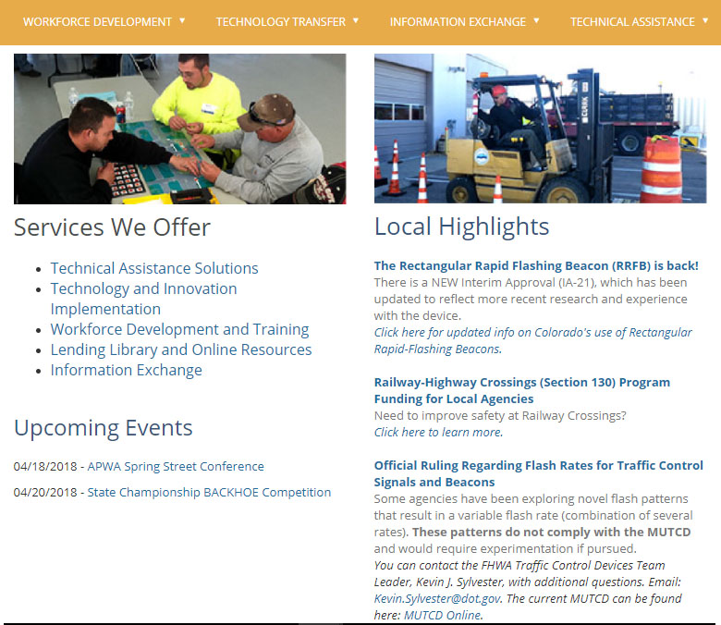
LTAP Services
Notes:
LTAP Services We Offer – www.ColoradoLTAP.org
HOME PAGE:
LTAP Services + Local Highlights + Upcoming Events + Newsletter + Local Innovation
SHOW RESOURCES ON EACH PAGE
Technical Assistance Solutions
“Ask a Question” & Past solutions
Technology and Innovation Implementation
Equipment Loan Program
Local Innovation Projects (YSU Entries)
Submit a Project
CDOT Lean Every Ideas
Project Guidelines and How To Guides
Curve Study, Site Distance, Restriping Lots
Lending Library and Online Resources (Same as Information Exchange)
Search library
**Manuals & Downloadable Resources – By Topic…
Safety – Show books
Infrastructure – Guardrail Resources
Workforce Devel – (Nothing here yet)
Emergency Management – Guidebooks mentioned
Workforce Development and Training
Click on “Upcoming Classes” link to see status of openings
“On Demand and Online Training Resources”
A LOT ON THIS PAGE – Gravel Road Maint Training, Stormwater, Safety Webinars
**Will off Online accessible training courses – COMING SOON.
Registration manager Accounts – Next Slide

Slide 10
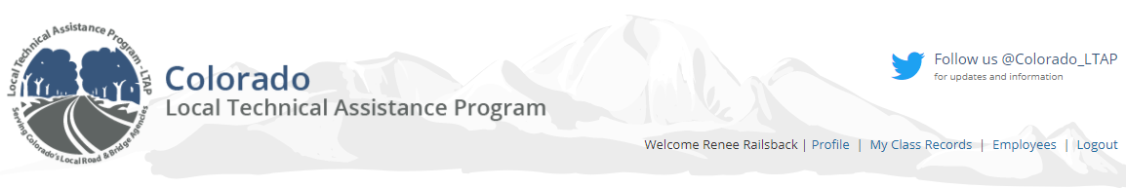
Manage Employee Training Records
Profile >> Edit Info or Add Yourself to Mailing Lists
My Class Records >> View Your OWN Upcoming & Past Classes
Employees >> View Employee Training Records
Print Past Certificates
PAY ONLINE BY CREDIT CARD
Notes:
“Registration Manager” or “Training Coordinator” Accounts
BULLETS:…..
View Employee Training Records >> Click on “Courses & Event History”

Slide 11
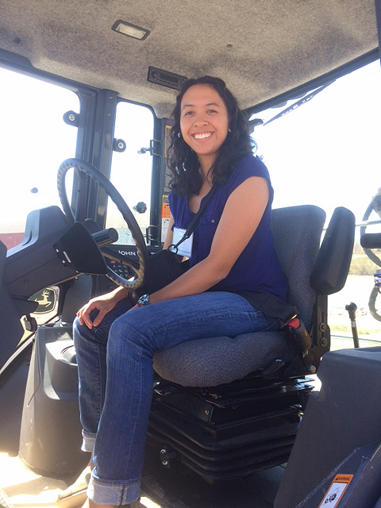
Big Changes…..
Farewell &
Good Luck
Sarah!

Slide 12
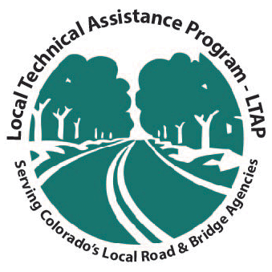
For more information…
Renée Railsback Sarah Wilson Liz Jefferson
Director Training Coordinator Grad Student
Local
cltap@colorado.edu
http://www.ColoradoLTAP.org
National
http://www.NLTAPA.org

