Slide 1
Arizona LTAP Center

Slide 2
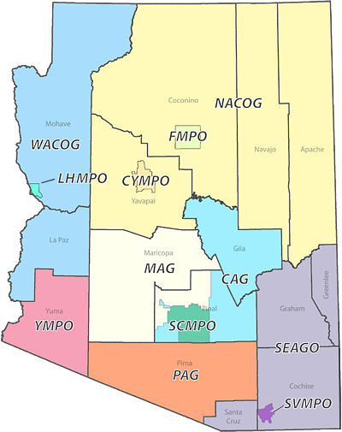
LTAP Center Structure
DOT-based Center
Within DOT, housed in ITD Technical Training Program
4.75 FTE staff (½ program manager, ½ marketing specialist, ½ time training coordinator, 3 full time trainers and .25 Budgeting Specialist)
Current annual budget = $300,000 K
Match from State and Local COG/MPO STP

Slide 3
Contributing Member Agency
Pay a fee of $100 per transportation employee
Transportation employees only
Excludes administrative-only staff
Certain certifications have an extra fee ex. CPR $20
No fee to attend any training put on directly by AZLTAP
Non Contributing Local Agencies can attend training for ½ the cost
Contractors/Consultants/Private Participants can attend the training at cost.

Slide 4
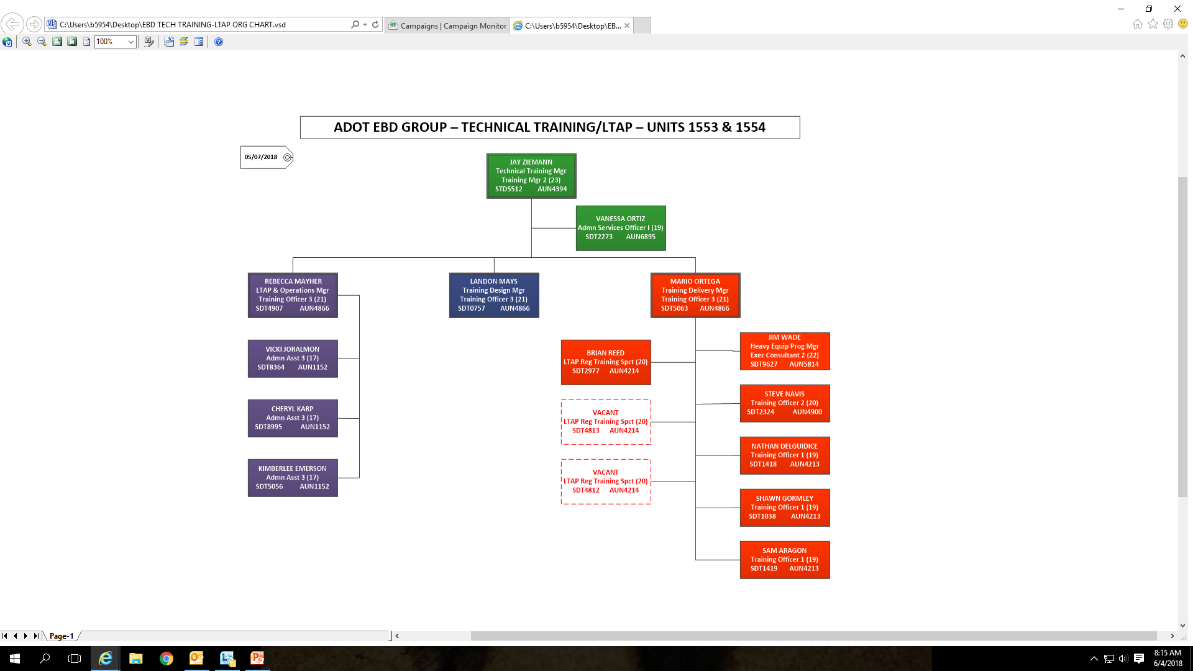

Slide 5


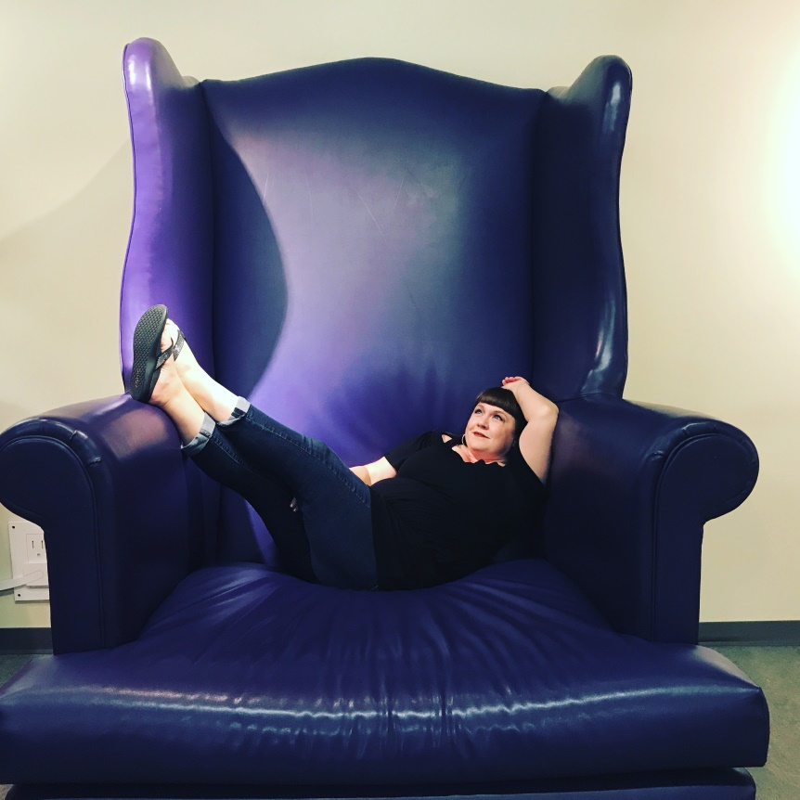

Questions?

