Slide 1


Slide 2
What can LTAP do for my County?
Technical Assistance
  Culverts & Small Structures
  Gravel Road Reshapes
  Agribusiness Access
  Materials
  Soft Spots
  Pavement Maintenance
  Stabilization & Dust Control
  Signing
Training
  Supervisor
  Operators
  Elected Officials
  Training Material and Handouts

Slide 3
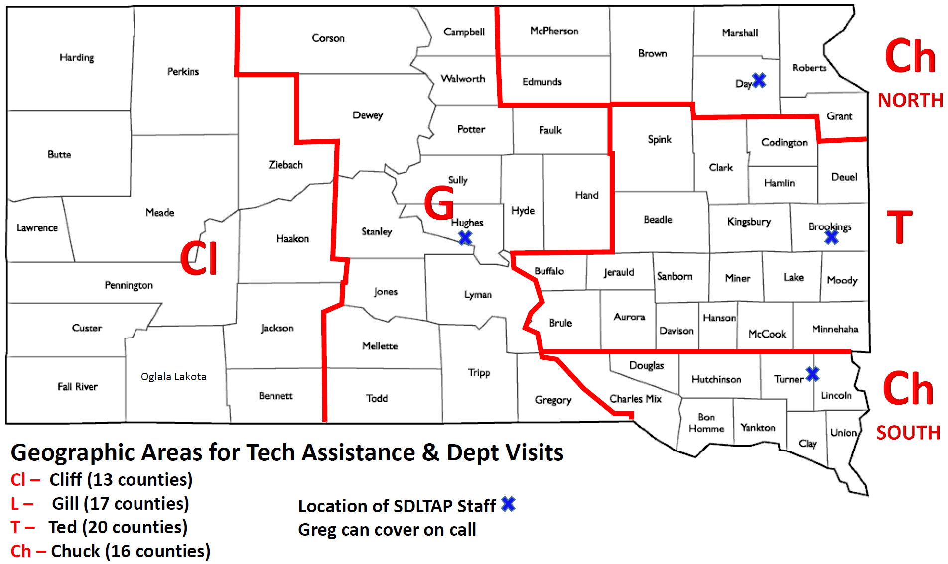
A
A -Andrew (20 counties)

Slide 4
Over 400 technical assistance visits
Cliff – Western Area
Chuck – Northeast & Southeast
Gill- Central Area

Slide 5
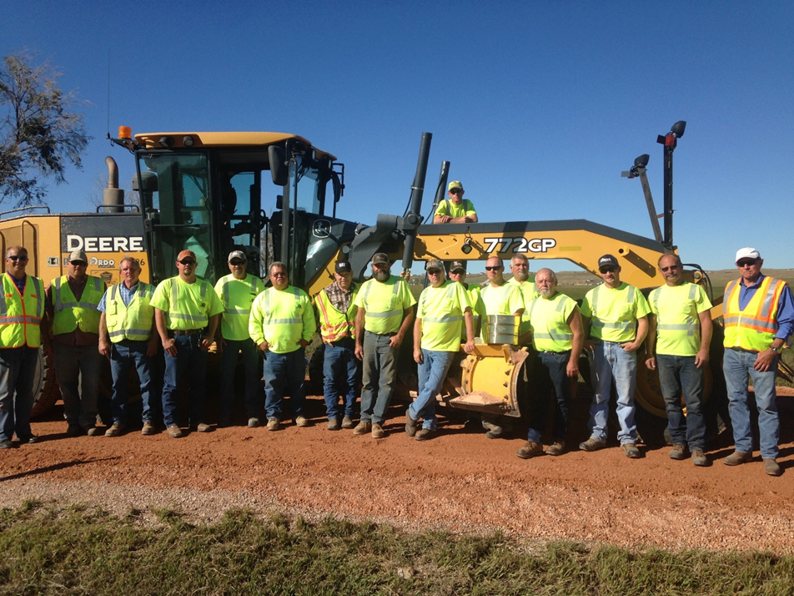
Training Numbers
59 training sessions
4,809 participants
14,351 participation hours

Slide 8
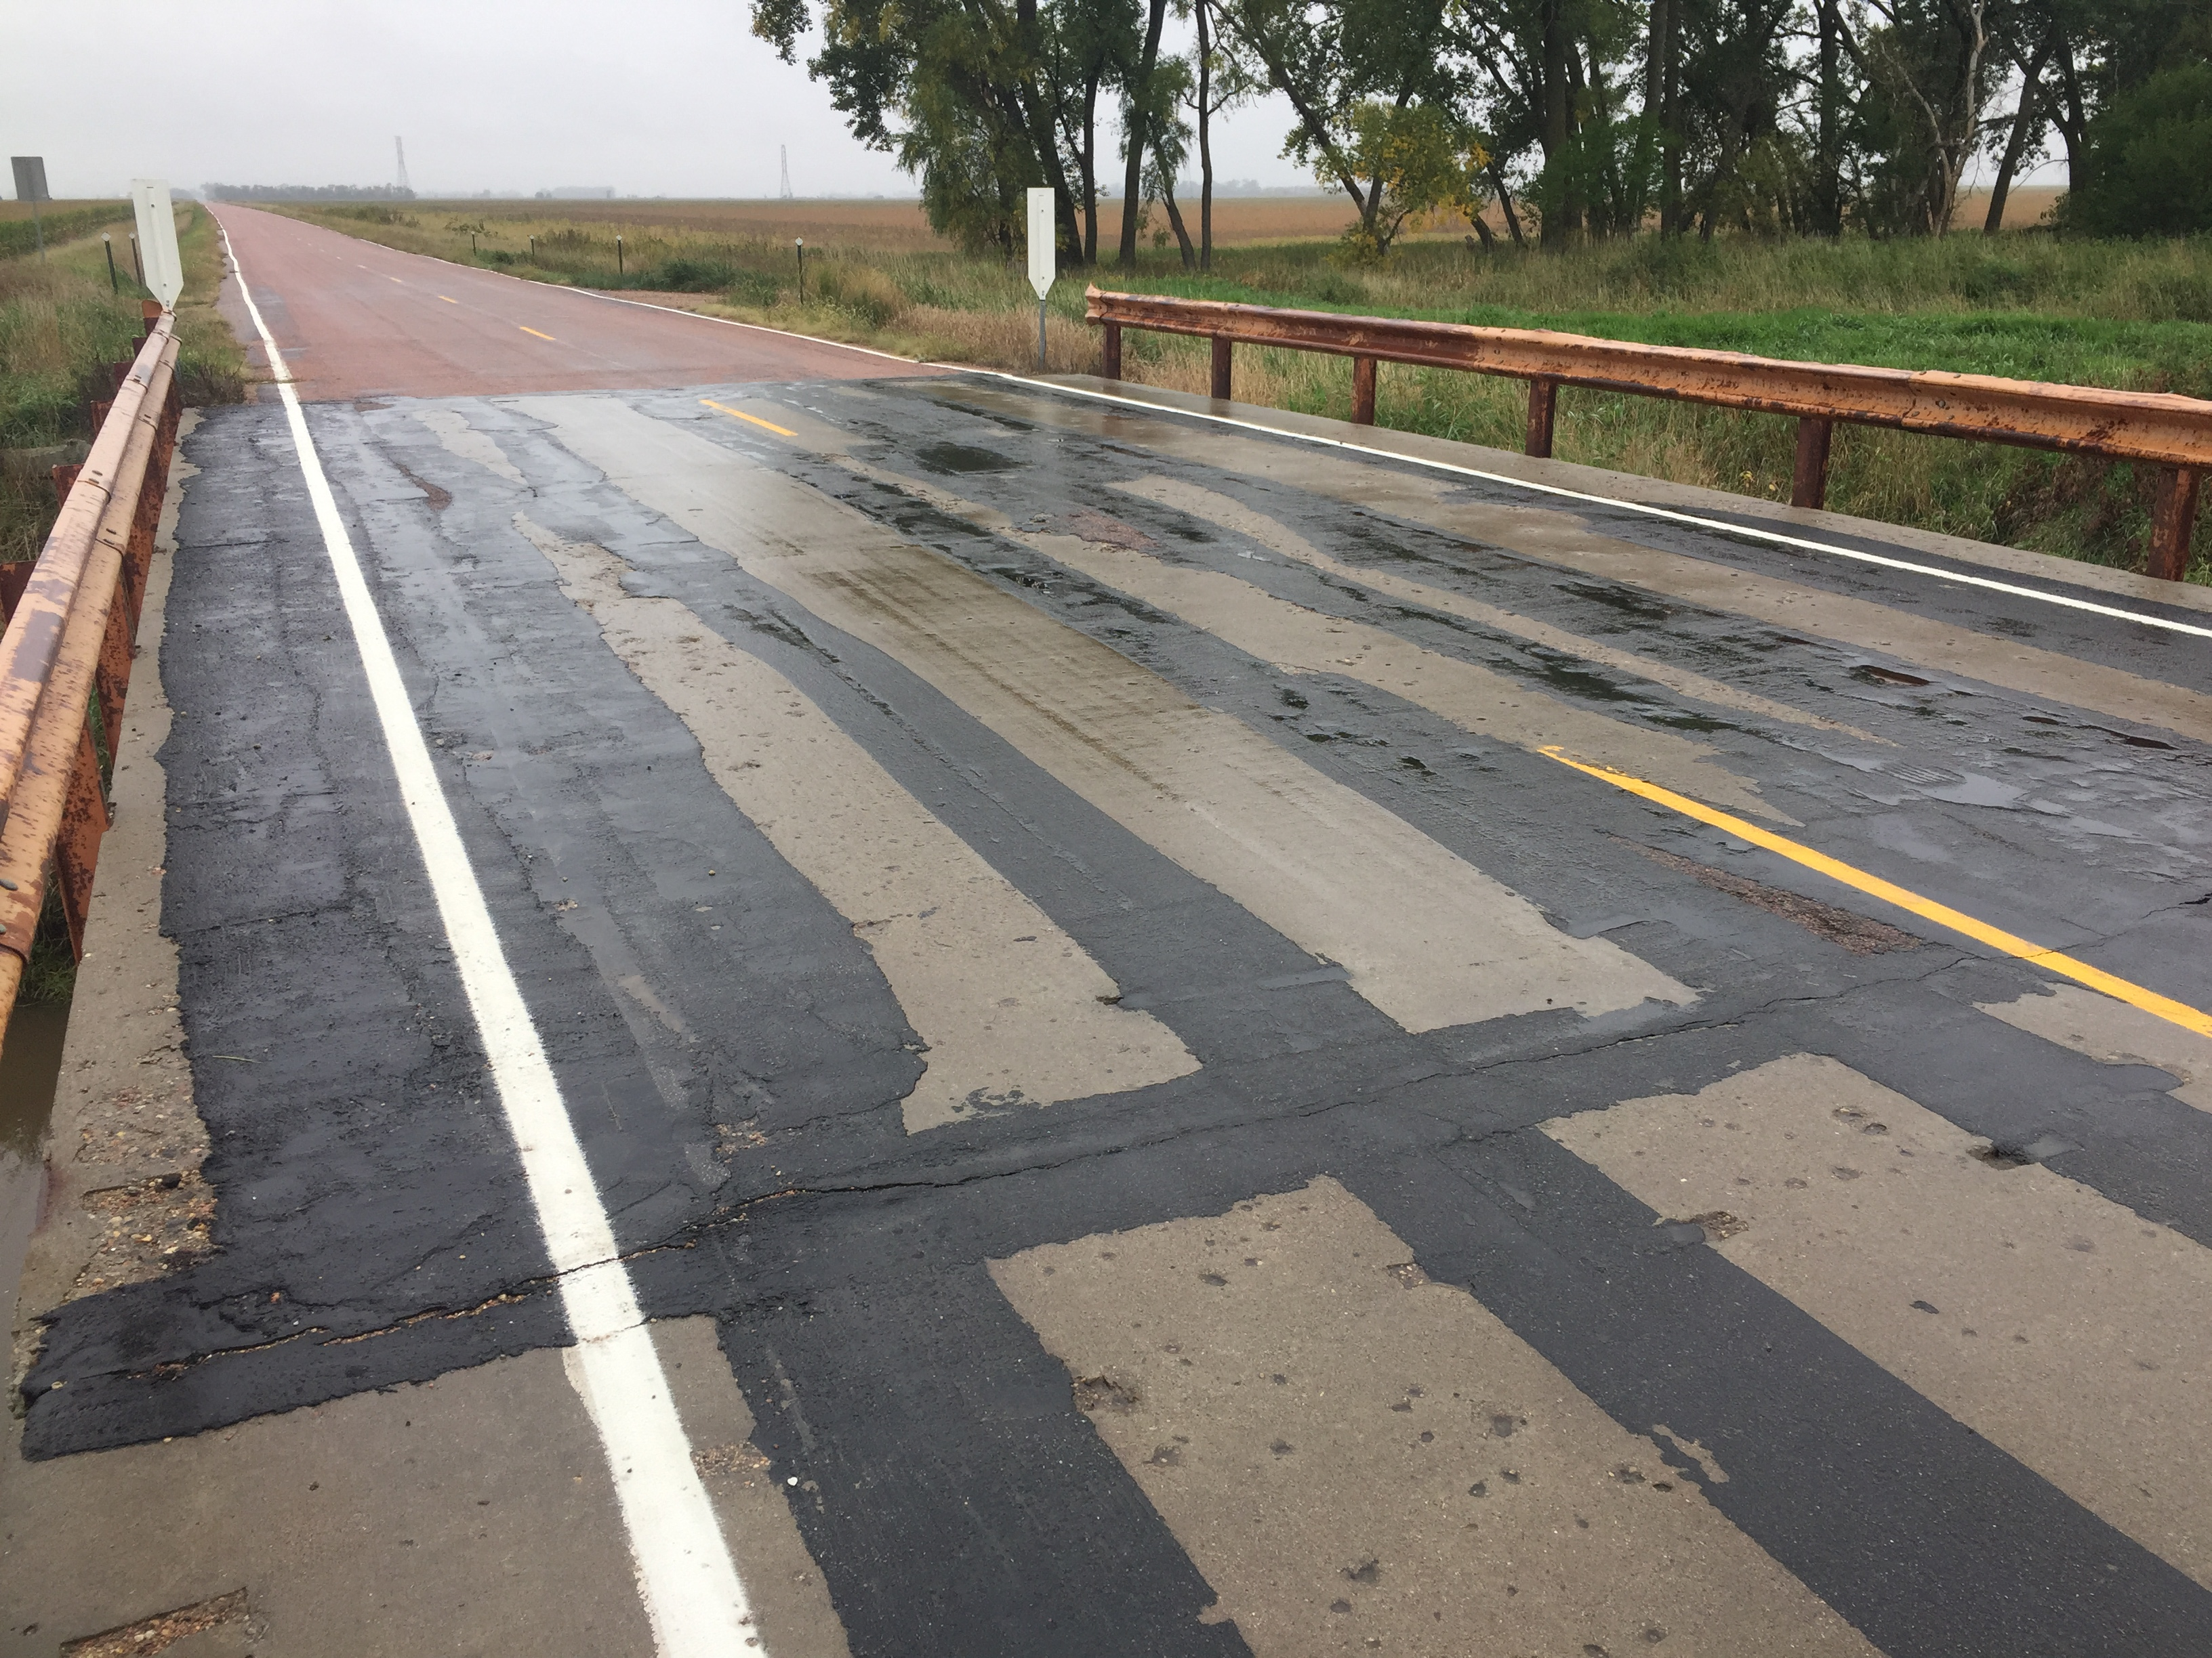
Innovation is key to being successful

Slide 9
Dealing with Winter Snow Maintenance
BY: SDLTAP

Slide 10
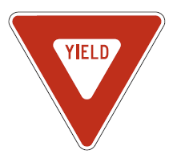

BASIC SIGNING
MANUAL ON UNIFORM TRAFFIC CONTROL DEVICES (MUTCD), 2009 EDITION
CLIFF REUER

Slide 11
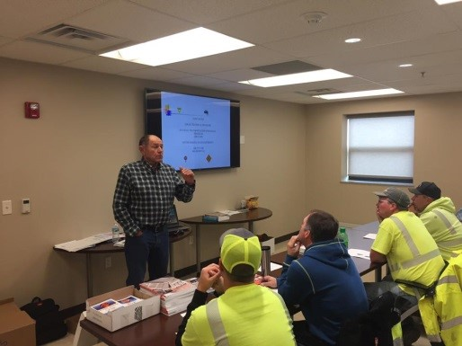

Slide 12
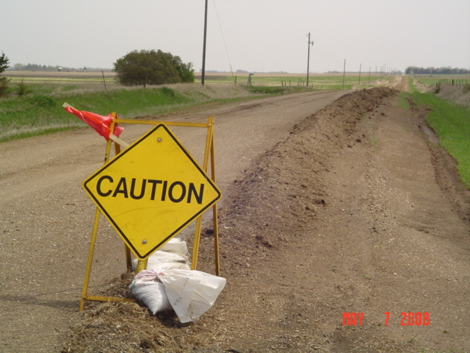


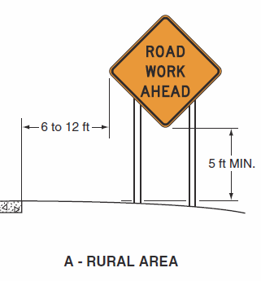
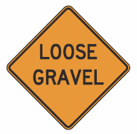
Always remember: warn the public!!

Slide 13
Updates From the SDDOT/SDLTAP Surface Gravel Study Project
Brookings Site Constructed in 2011

Slide 14
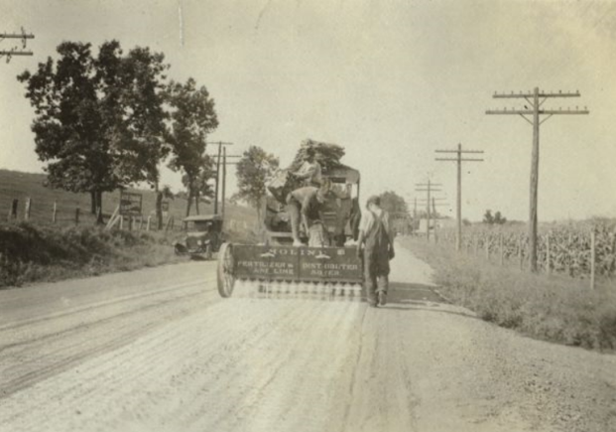
Feasibility of Dust Control or Stabilization

Slide 15
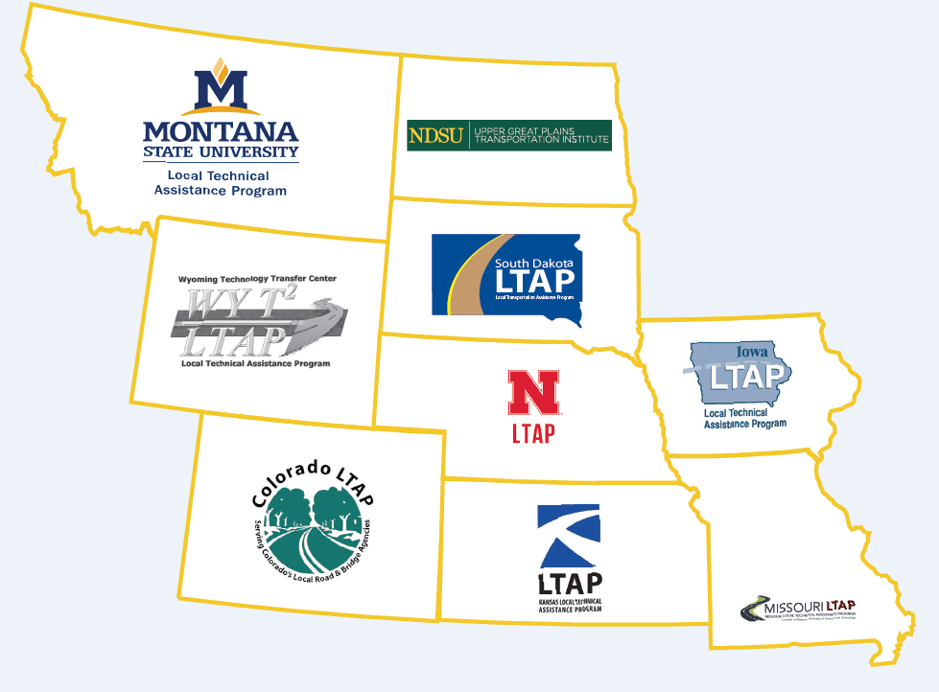
North Central Region Conference

Slide 16
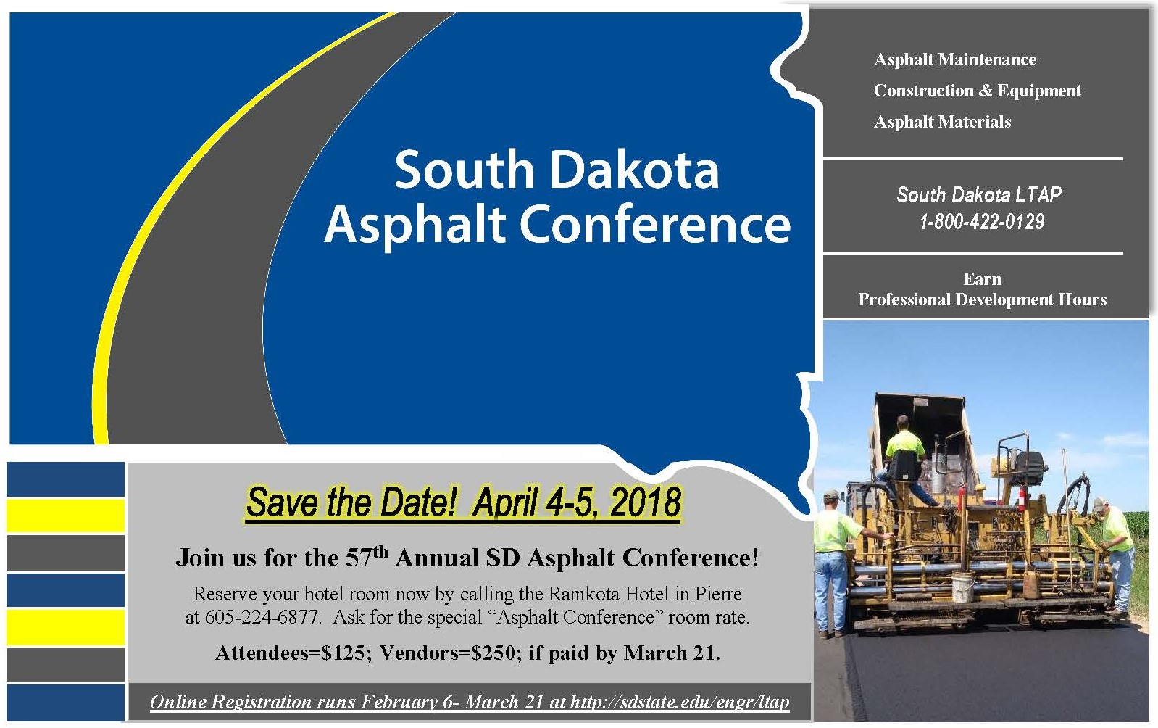

Slide 17
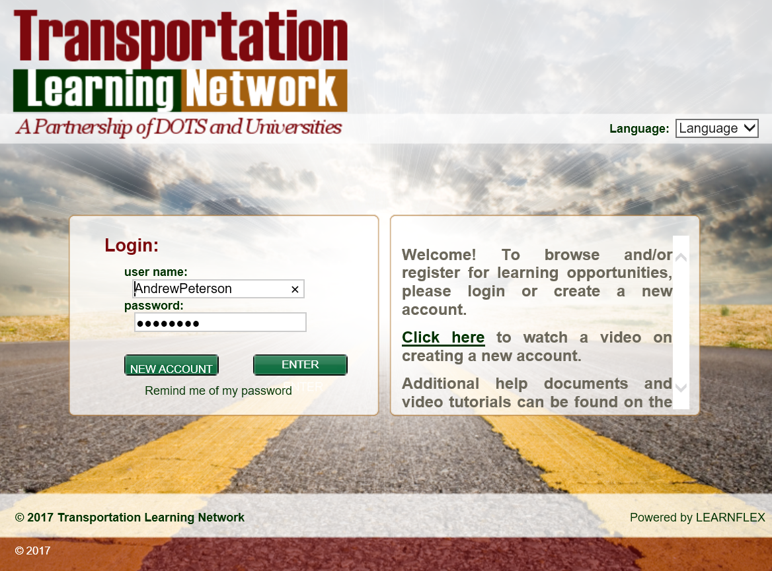

Slide 18


